Slide 1
Bootcamp Journey… week 1 & 2
Arsh Vohra

Slide 2
timeline
Foundation skills
(BA & AGILE)
18 & 21 August 2023
SOFT SKILLS
14-17 Aug 2023
Foundation skills
(SQL)
22 Aug 2023
DevOps & Testing
23 & 24 Aug 2023
CLOUD computing
25Aug 2023

Slide 3
Day 1
Introduction to Business Analysis Functional and Non-functional requirements Requirements Elicitation Requirements Modelling Requirement Management Techniques Requirements Traceability SDLC Model

Slide 4
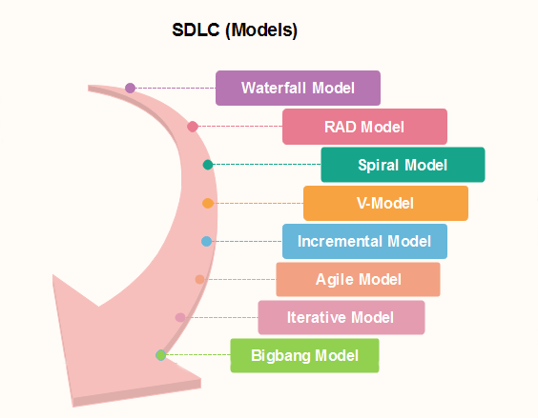
Day 1…
Waterfall Model
Agile Method
Scrum Events
Kanban Board
Role play to demonstrate agile methodology- Phases in Scrum
Assignment on Requirement Traceability- Excel Sheet

Slide 5
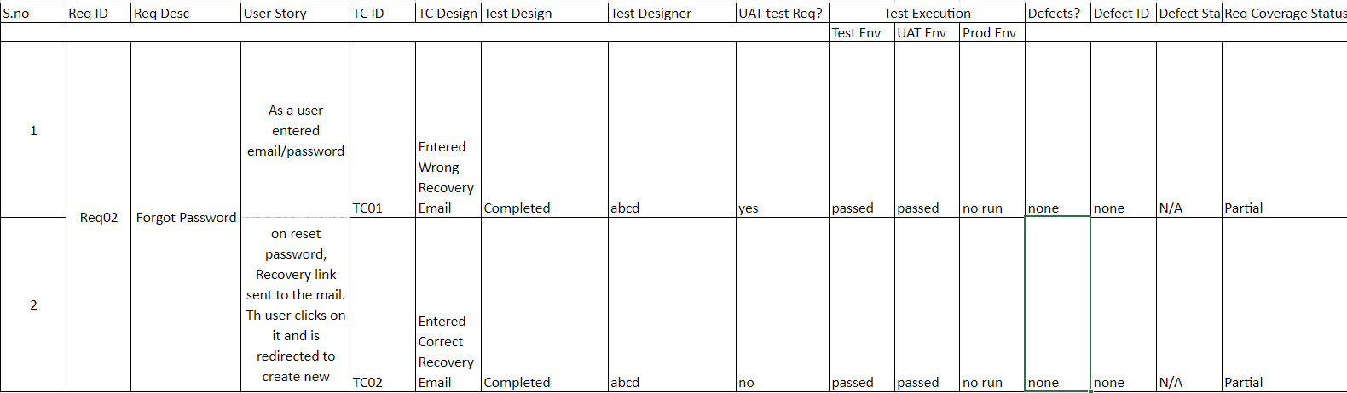

Slide 6
Day 2
Introduction to Dev Ops
Creating EPIC, User Story, Tasks and Sub-tasks
Story point estimation
Scrum fundamentals
Sprint backlog
Burnup, Burndown, Velocity Charts
Hands-on practice on Azure

Slide 7
Day 3 SQL
Relational Database Management System
DML/DDL/TCL/DCL commands
Types of Joins
Normalization forms
Subqueries
Self Reference
Extracting information using SubQuery

Slide 8
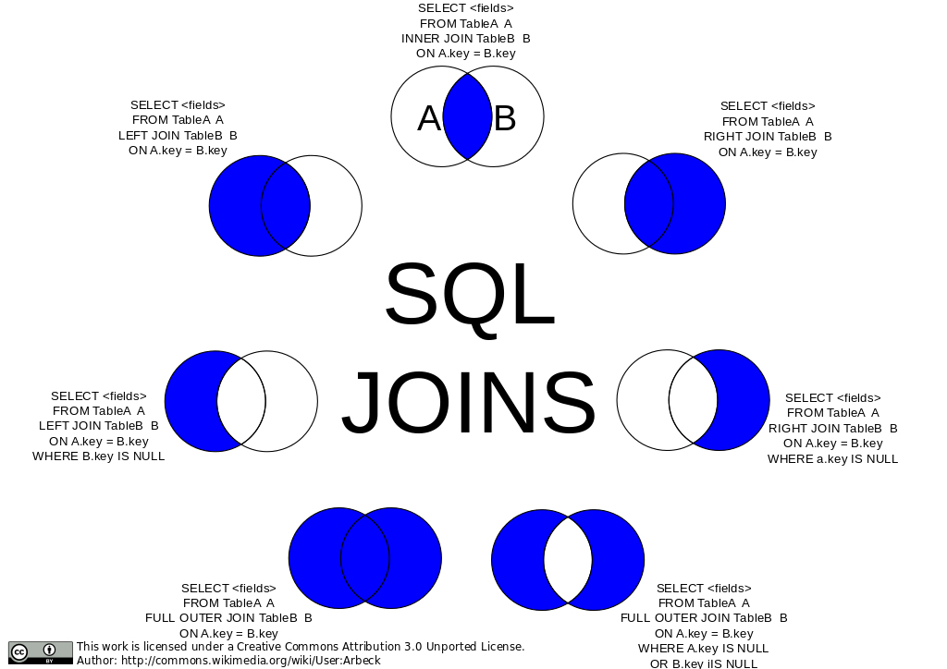

Slide 9
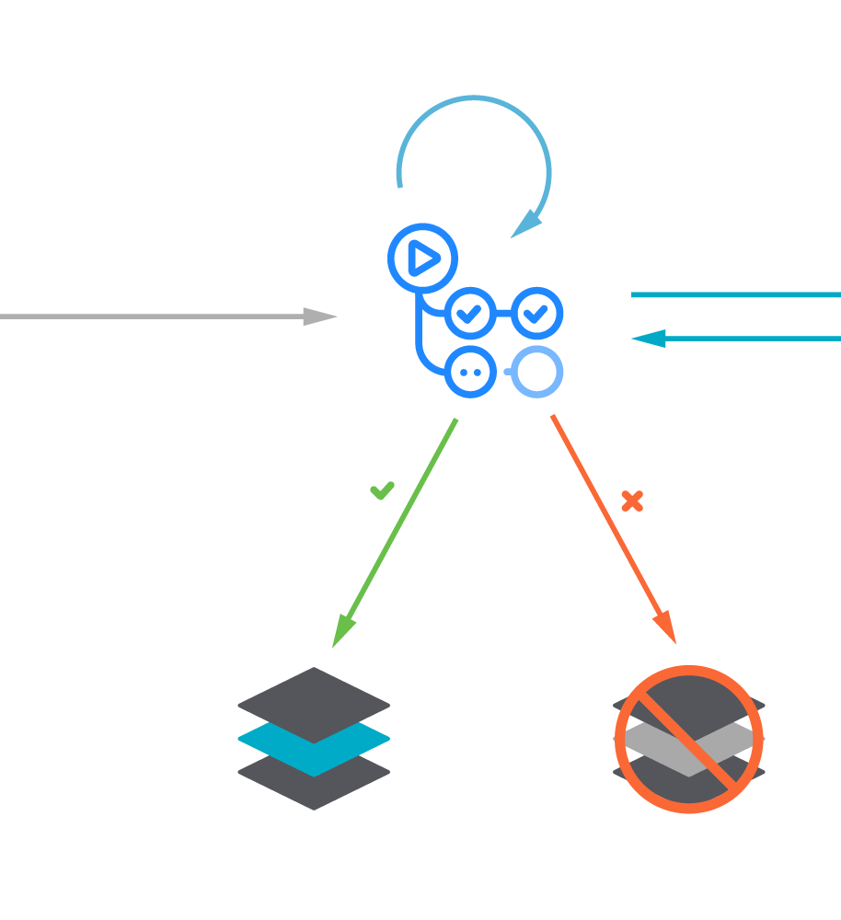
Day 4 Devops
DevOps Life Cycle
DevOps Tools & Strategies
CI/CD
Introduction to GitHub Actions
Components of GitHub Actions

Slide 10
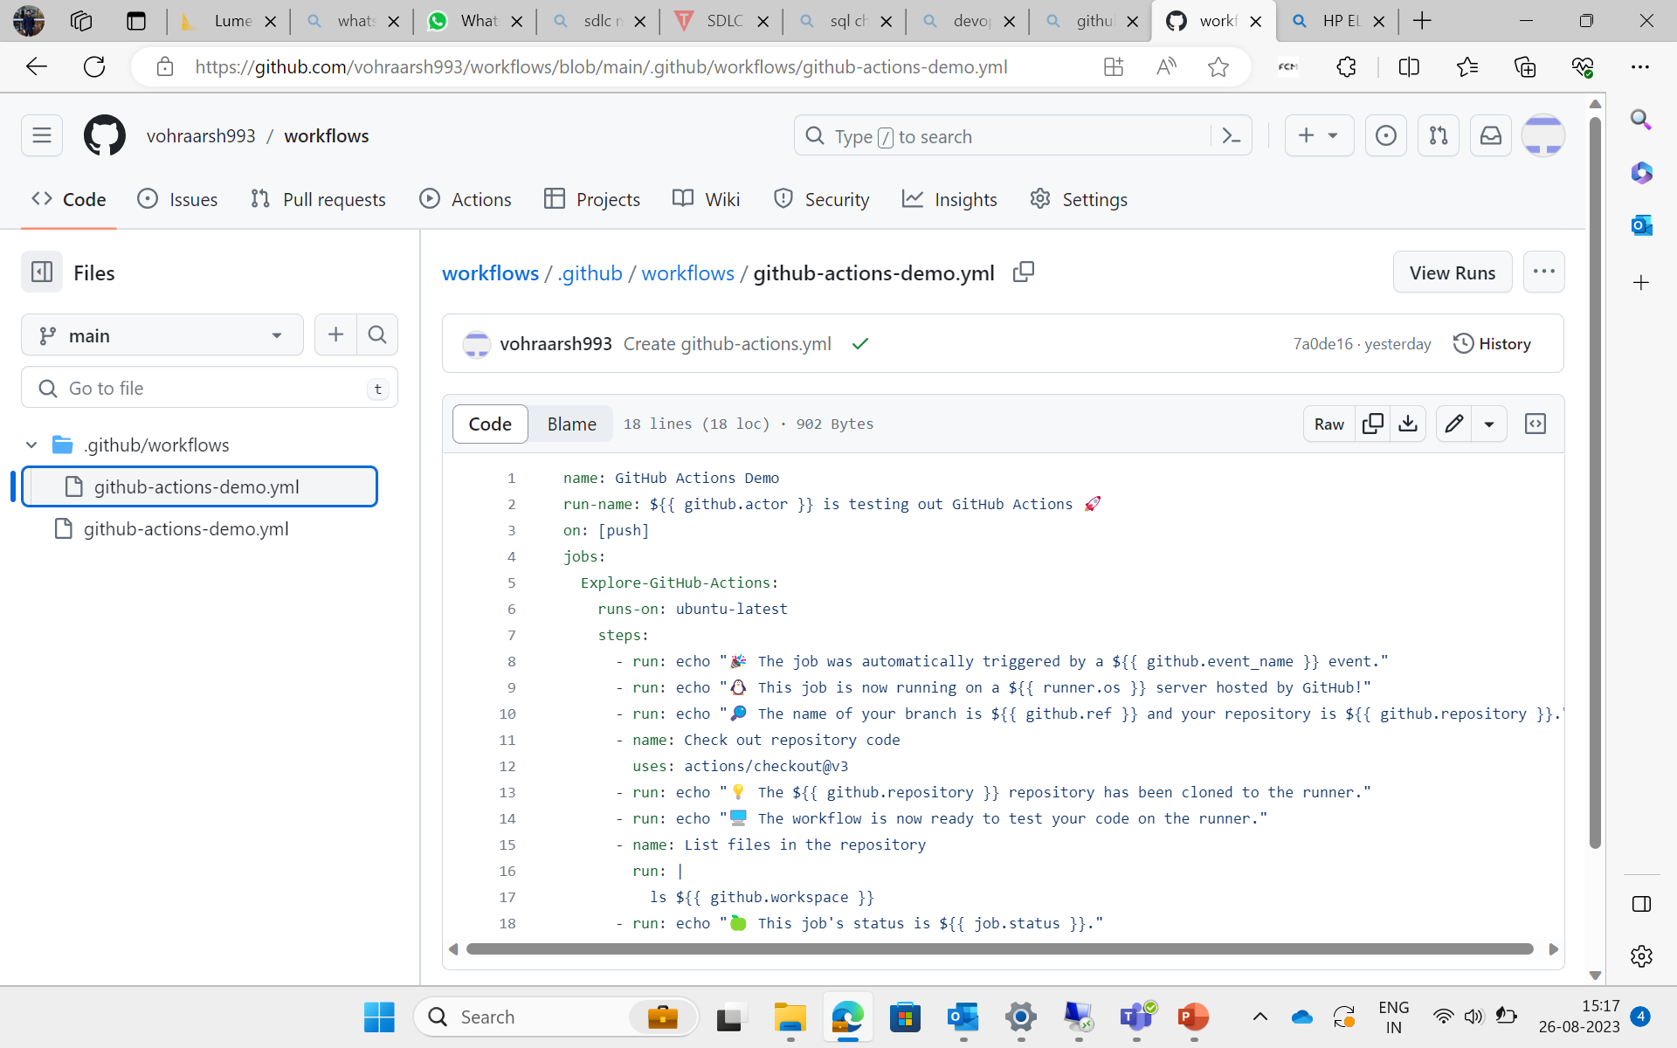




meet our team
TAKUMA HAYASHI
MIRJAM NILSSON​
FLORA BERGGREN​
RAJESH SANTOSHI
president
chief executive officer
chief operations officer
vp marketing

Slide 11
Day 5 Software Testing
Blackbox vs Whitebox vs Greybox testing
Software test life cycle
Testing triangle
Manual & automation testing
Unit testing

Slide 12
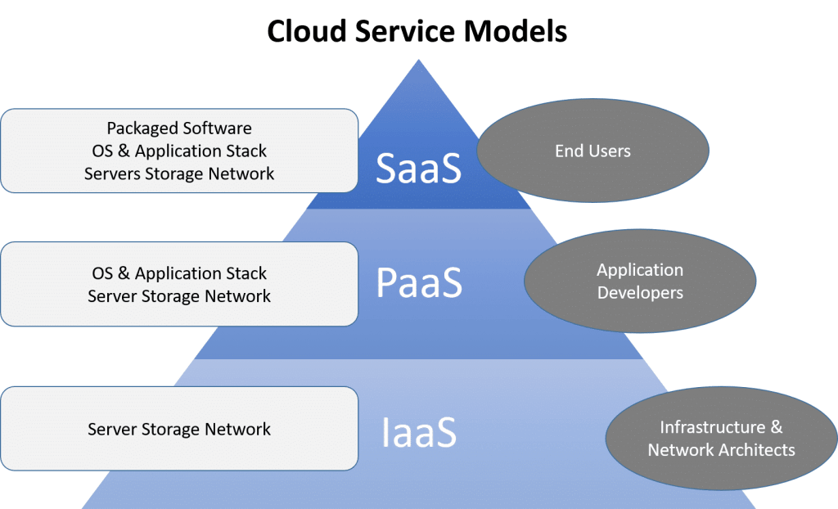
Day 6 Cloud Computing
Cloud architecture
CLOUD SERVICE MODELS
CLOUD Computing service layers
Azure vs aws vs google cloud
Cloud storage and taxonomy

Slide 13
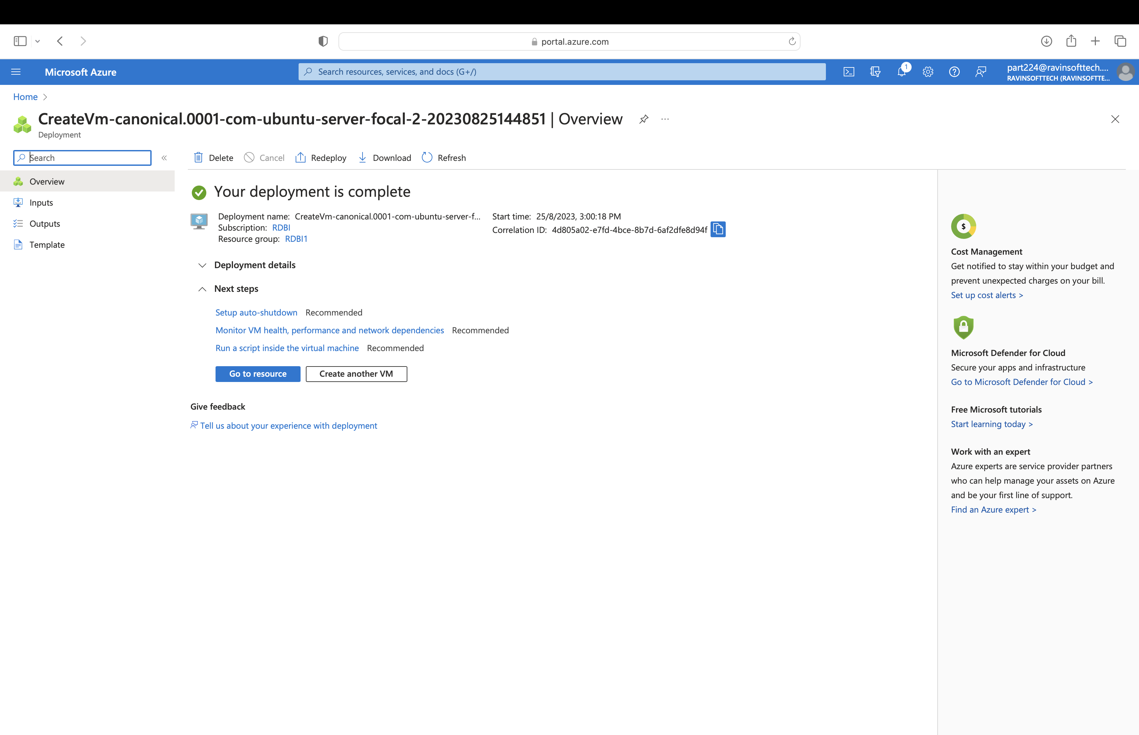
how we get there
ROI
NICHE MARKETS
SUPPLY CHAINS
Envision multimedia-based expertise and cross-media growth strategies
Visualize quality intellectual capital
Engage worldwide methodologies with web-enabled technologies
Pursue scalable customer service through sustainable strategies
Engage top-line web services with cutting-edge deliverables
Cultivate one-to-one customer service with robust ideas
Maximize timely deliverables for real-time schemas

Slide 14
DAY-7
Case Study – Deployment Of Java Spring Boot App
Azure Devops
Azure VM
Azure Web App Services
GitHub – Fork, Feature Branch, Pull Request, Merge
GitHub Actions – Automate Workflow
Docker – Make Docker Image And Dockerfile
Maven – Run Maven Package
Prometheus – To Monitor Local Environment
Case Study Evaluation and Assessment

Slide 15
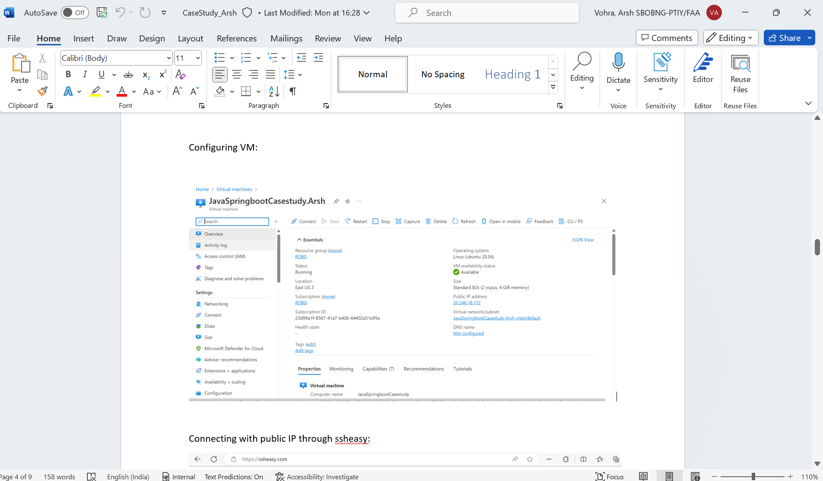

Slide 16
Bootcamp Journey… week 3
Arsh Vohra

Slide 17

DAY-8
What Is Data?
Types Of Data
What Is Database?
What Does Data Engineer Do?
Normalization And Denormalization
Normalization Forms (1NF,2NF,3NF,BCNF)
Dependencies (Partial, Transitive, Functional)
Attribute Keys (Candidate, Primary, Foreign, Super)
Anomalies- Insert, Update, Delete
Data Modelling And ER Diagram
Activity- To Make An ER Diagram For Ordering A Book From Online Store, Perform Normalization
Dimensional Modelling
Fact Table And Dimension Table
Star Schema & Snowflake Schema
Activity- Implement The Concepts Of Star And Snowflake Schema By Drawing Respective Diagrams
SCD (Slowly Changing Dimension)
Data Fundamentals

Slide 18

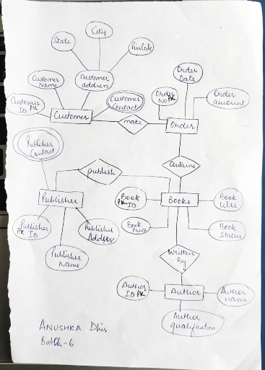
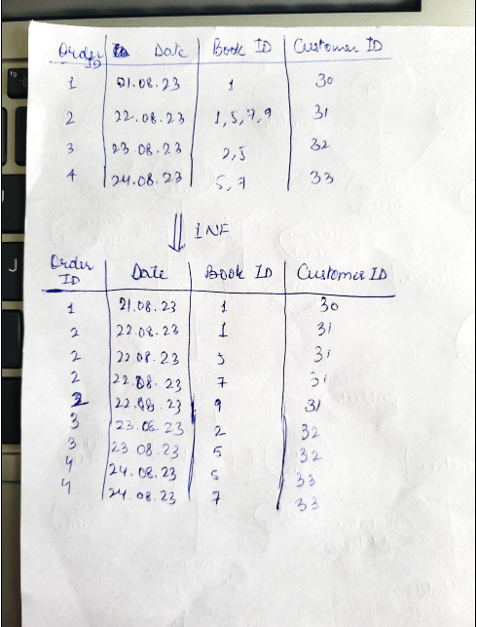
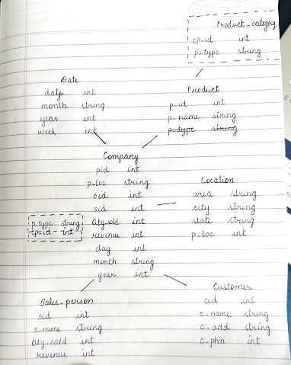

Slide 19
Big Data Fundamentals
What Is Data?
What Is Big Data?
4 V's Of Big Data - Volume, Variety, Velocity, Veracity
Batch And Stream Data Processing.
Extract, Load, Transform(ETL) Pipelines
How To Process Big Data?
Hadoop
Pyspark
Parallel Processing And Distributive Computing
Hadoop Used For Batch Processing & Pyspark Used For Stream Processing.
Types Of Data Structure
Structured Data
Semi-structured Data
Unstructured Data
Data Warehouse -
Save Data As Object
Tables
Views
Structured Data (Fixed Schema-data Allocated Even If Value Is Null)
Dimension Modelling
ACID Property In DBMS -
Atomicity
Consistency
Isolation
Durability
Datalake -
Saves All Types Of Data (Structured, Semi-structured And Unstructured)
Flexible Schema (No Data Allocated For Null Values)
No ACID Properties
DAY-9
Big Data & Azure Services Fundamentals

Slide 20
DAY-9
Big Data Fundamentals (Contd.)
Data Lakehouse
Combination Of Data Warehouse And Datalake.
Took Advantages Of Both Data Warehouse And Datalake.
Creating A VM Using Microsoft Azure.
What Is Cloud Computing.
Types Of Cloud -
Public Cloud
Private Cloud
Hybrid Cloud
Cloud Benefits -
High Availability
Scalability
Agility
Fault Tolerance
Elasticity
Security
Disaster Recovery
Customer Latency Capabilities
Compare Capex(capital Expenditure) Vs OpEx(operational Expenditure) -
Cloud Is OpEx.
Infrastructure As A Service(IAAS)
Platform As A Service(PAAS)
Software As A Service(SAAS)
Shared Responsibility Model
Serverless Computing
Big Data & Azure Services Fundamentals

Slide 21
DAY-9
Azure Services Fundamentals
Azure Architecture
Regions
Region Pairs
Availability Zones
Azure Resources
Azure Subscriptions -
Billing Boundary
Access Control Boundary
Azure Resource Manager
Resource Groups
Subscriptions -> Resource Groups
Big Data & Azure Services Fundamentals

Slide 22
DAY-10
Setting Up Azure SQL Services By Logging In On Azure Portal.
SQL Deployment Options For Azure SQL:
SQL Database
SQL Managed Instances
SQL Virtual Machines
Select SQL Database -> Single Database -> Create Database.
Introduction To SQL
Database Created On Microsoft Azure SQL.
Running Query Editor On Our Server.
DDL (Data Definition Language): create, Alter, Drop, Truncate
DML(data Manipulation Language): Select, Insert, Update, Delete
DCL(data Control Language):grant, REVOKE
Constraints
View: View Is A Virtual Table Based On The Result-set Of An SQL Statement.
Schema In Sql
Difference Between DELETE, DROP, TRUNCATE.
Activity : Create Tables For Online Book Store
Group By Clause
Having Clause : For Filtration
Where Clause
GRANT: Grant Select Permission On <Table_name> To <User>
Revoke
Azure SQL

Slide 23
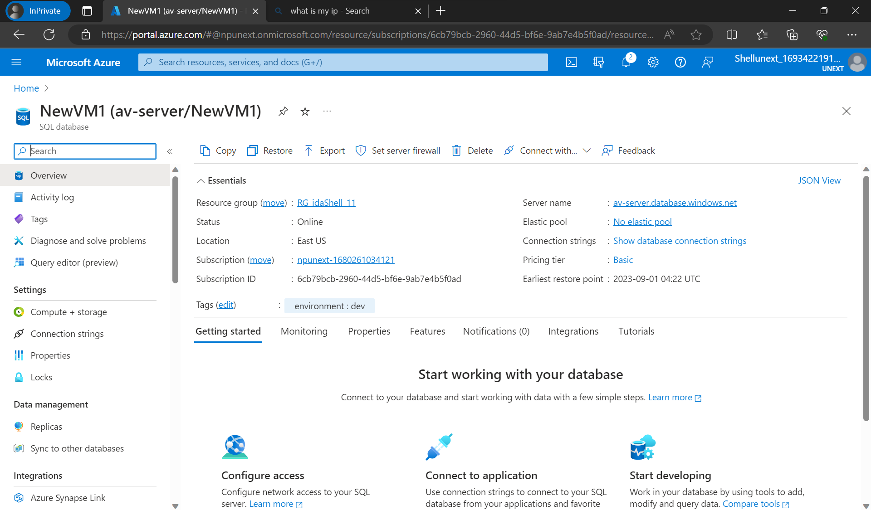

Slide 24
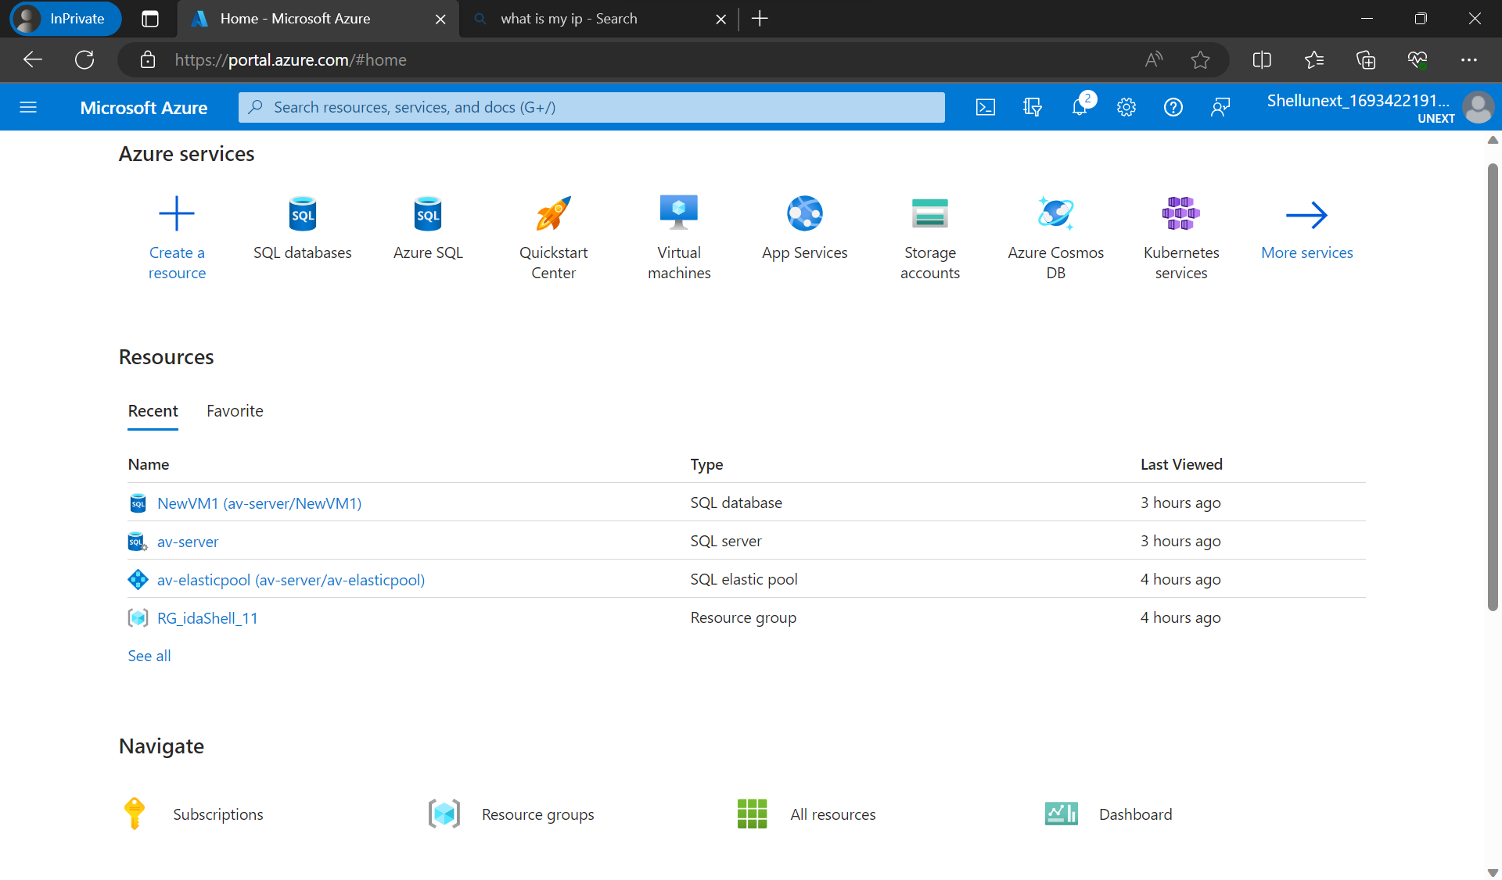

Slide 25
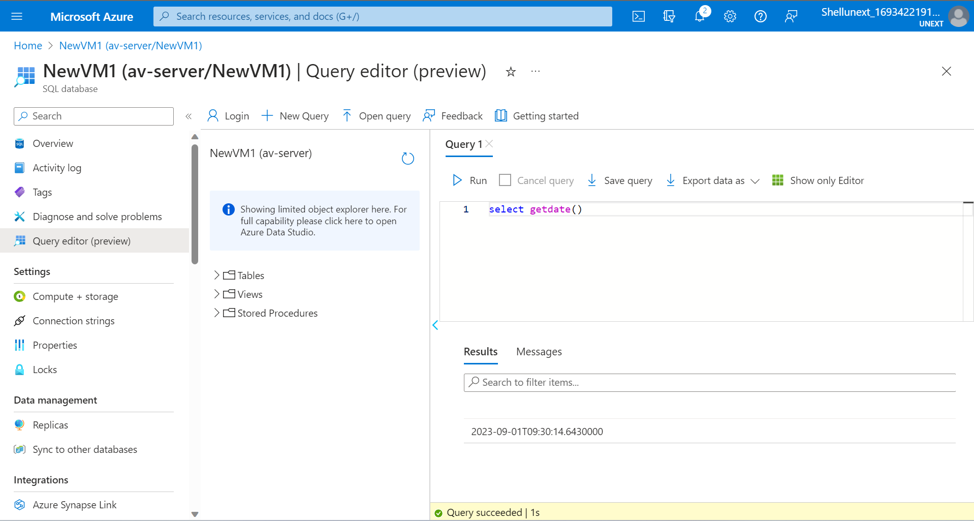

Slide 26
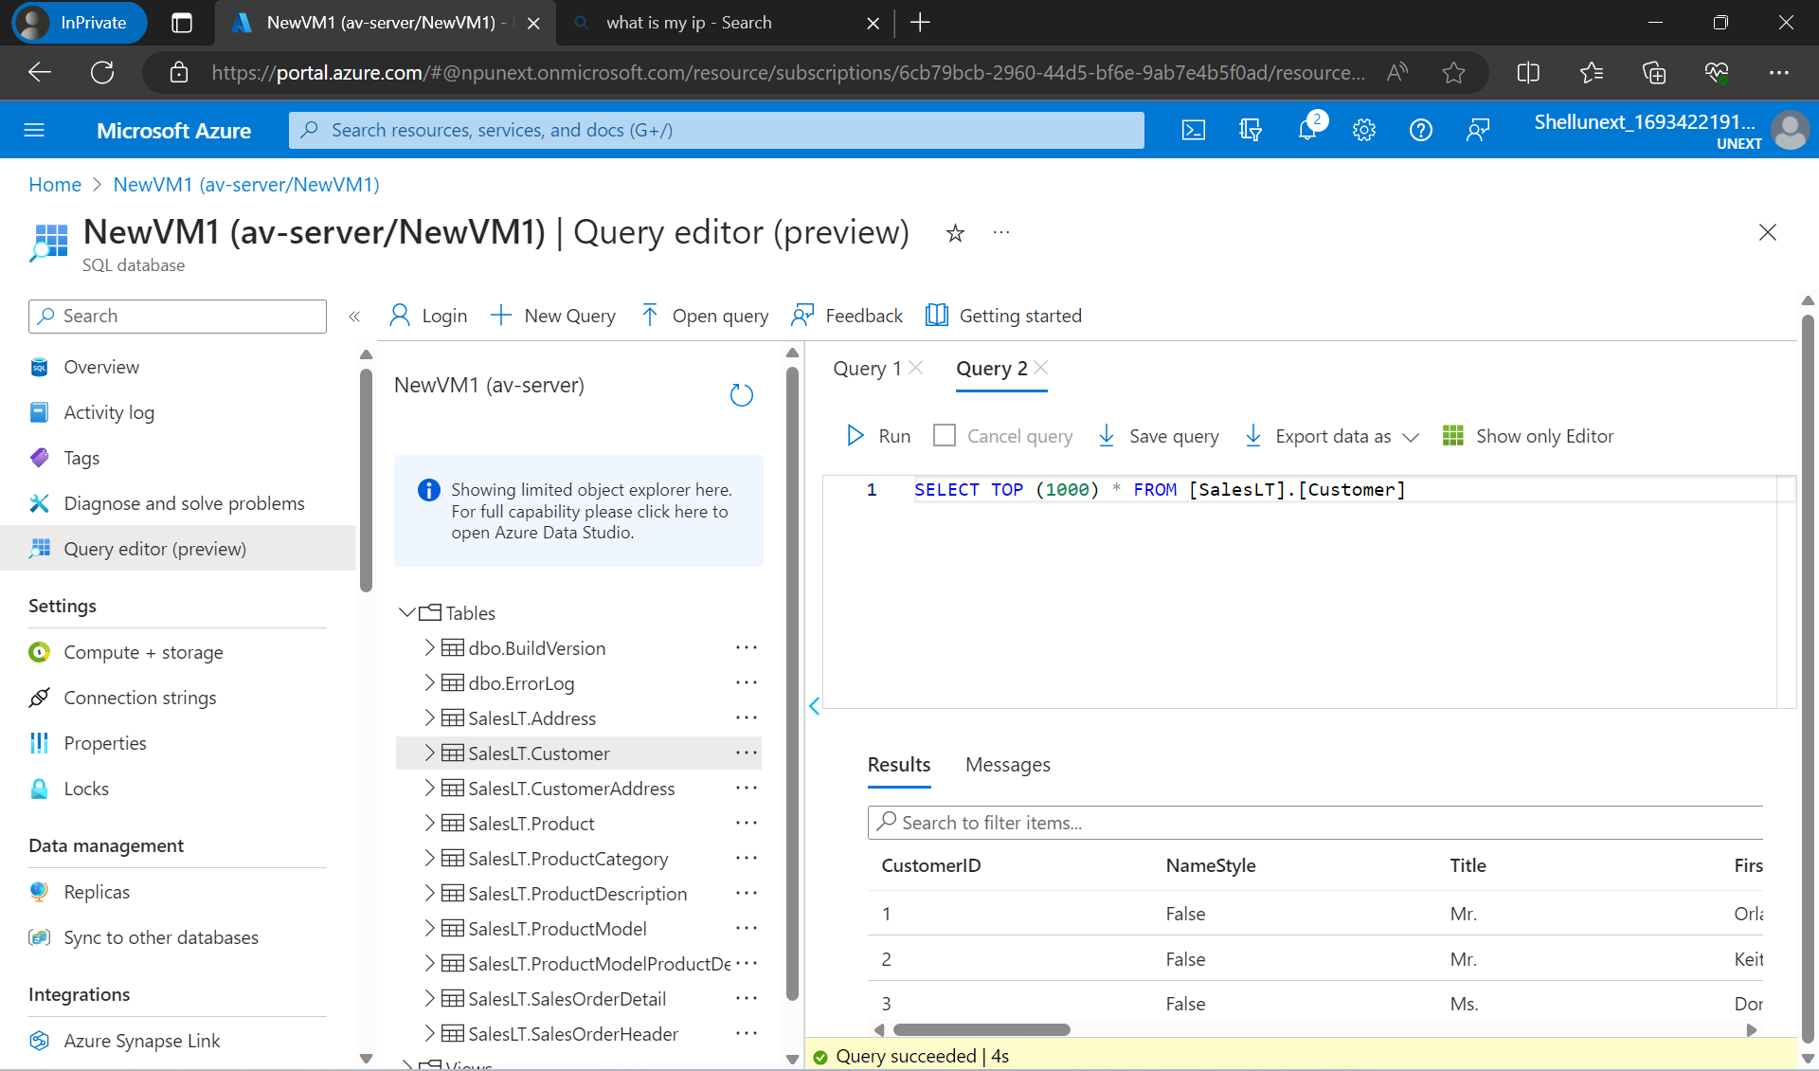

Slide 27
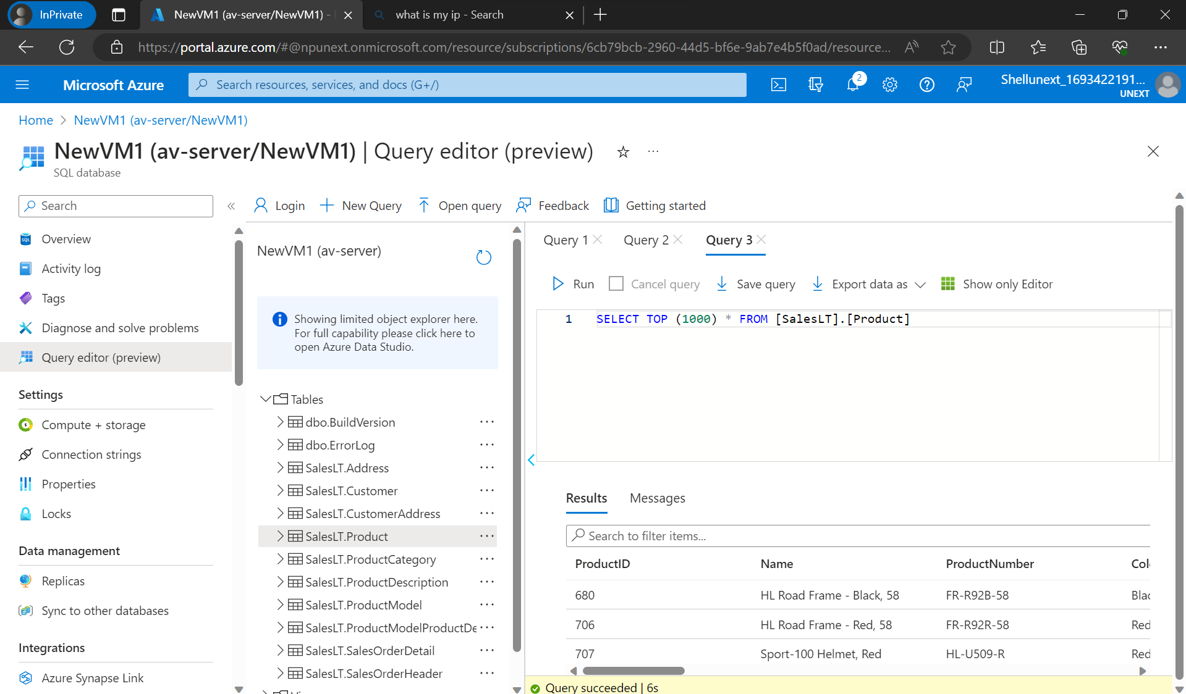

Slide 28
Bootcamp Journey… week 4
Arsh Vohra

Slide 29
DAY-1
Create A Resource -> Azure Storage Account
Resource Group
Storage Account
Storage Services
Redundancy
Local Redundancy
Zone Redundancy
Geo Redundancy
Geo Zone Redundancy
RAGRS (Read Access Geo Redundant Storage)
Failover
Synchronous Replication
Security
Access Protocols
Access Tiers
Hot
Cold
Cool
Archive Access
Purging & Archiving
Containers - Folder For Storing Files
Azure Tables
Azure Queues
File Shares
Snapshots
Ingress & Egress
Static Website
Azure Storage Types- Day 1

Slide 30
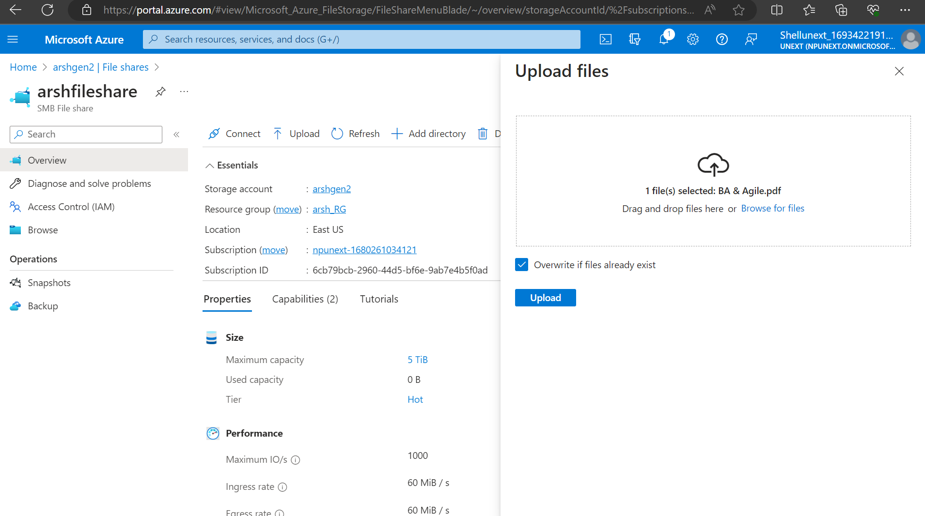
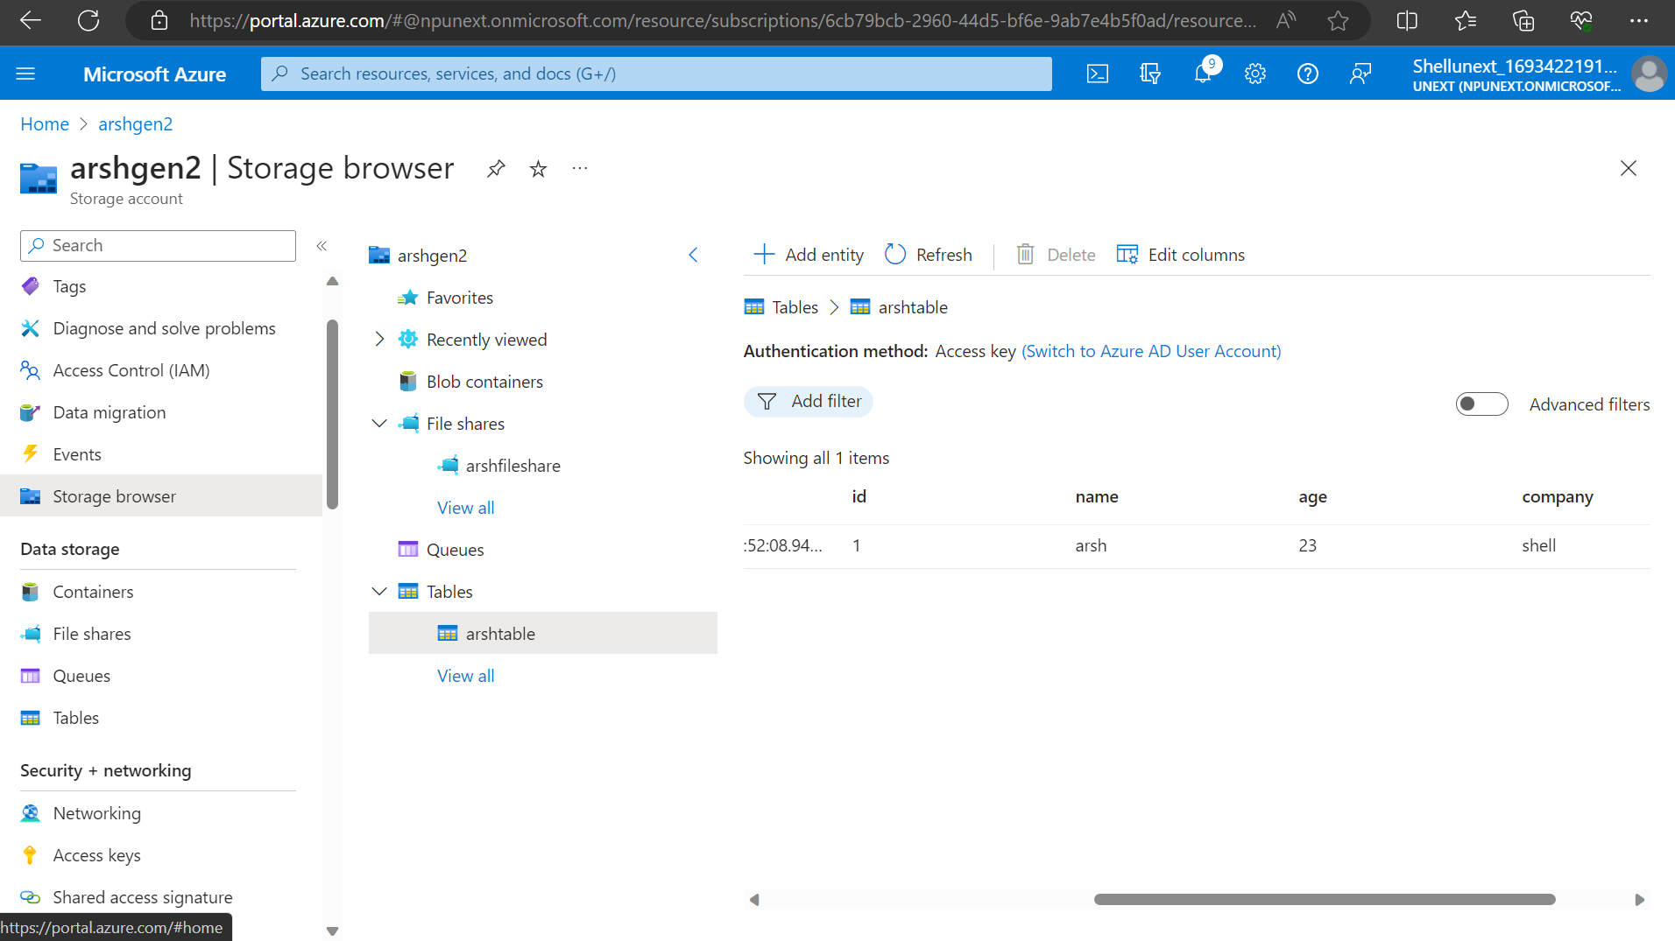
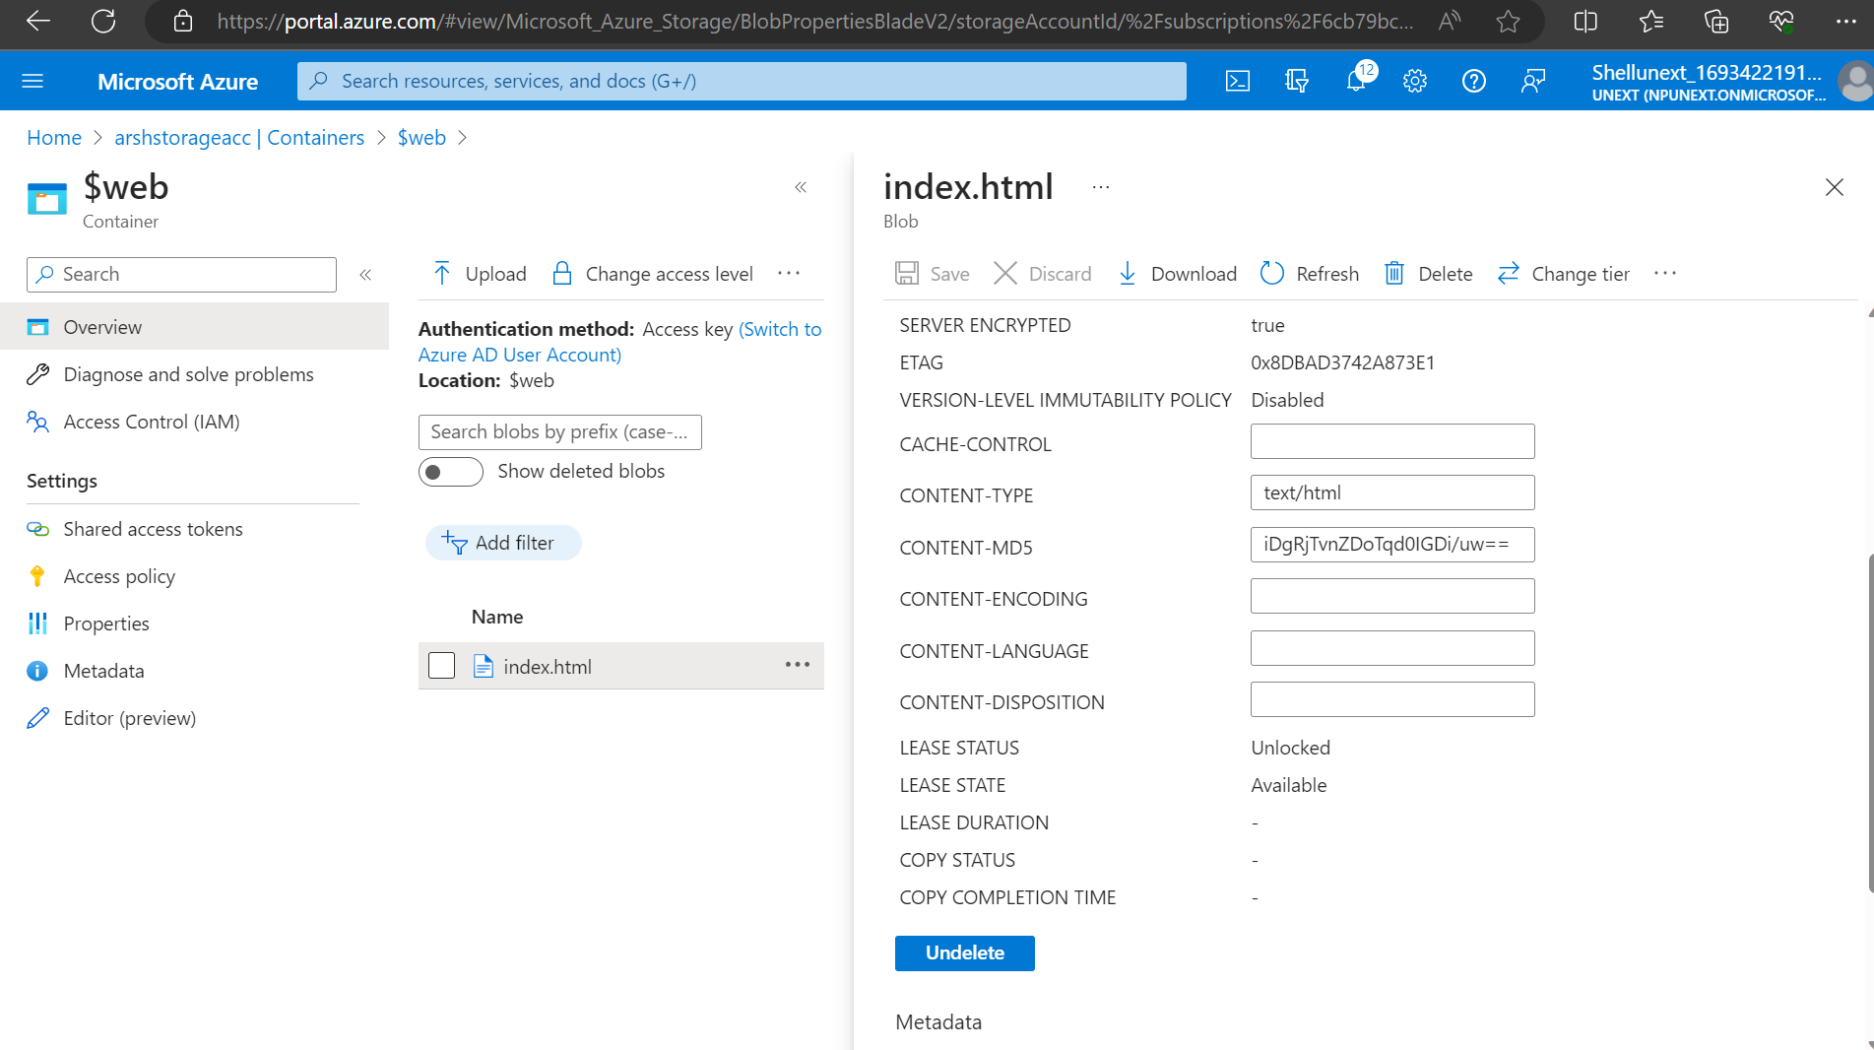
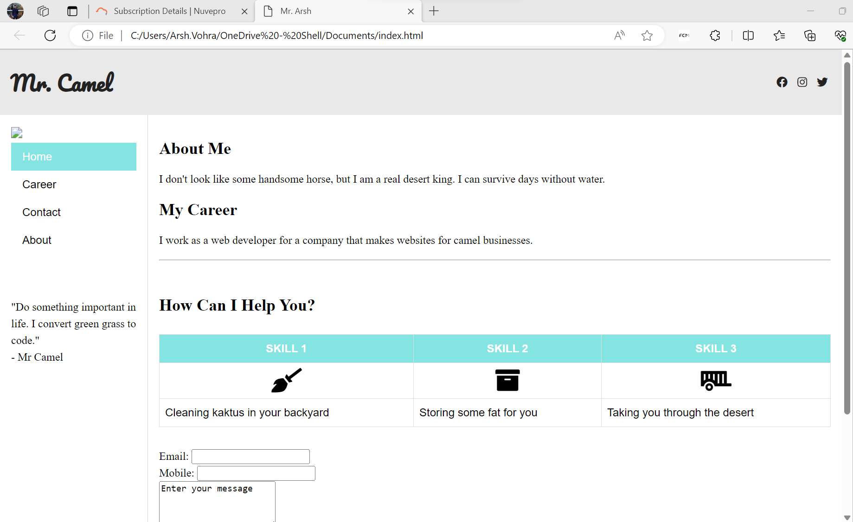
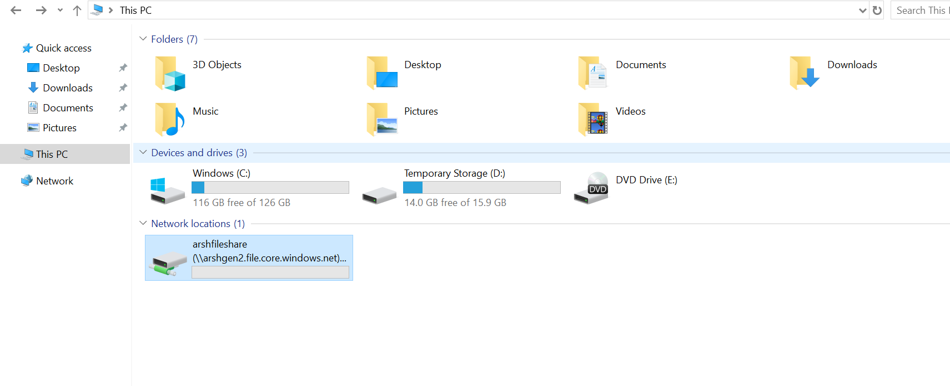

Slide 31
DAY-2
Access Keys : Lifetime
SAS (Shared Access Signature) : Time-bounded
Azure Key Vaults
Access Control (IAM) : Check Access Here
Azure Data Factory :
Data Engineer Activities:
ETL (Extract,Transform,Load)
ELT
Azure Databricks - Transformation
Data Orchestration
ADF Components:
Pipelines : Combination Of One Or More Activities
Activities
Datasets
Linked Services : To Access Particular Directory This Is Used.
Integration Runtime : Gateway Or Bridge To Connect For Data Extraction.
Azure Auto Resolved (Default)
Self-hosted
Azure SSIS
Triggers
Data Flow
Parameterization
Pipelines
Azure Storage Types- Day 2 & Azure Data Factory

Slide 32
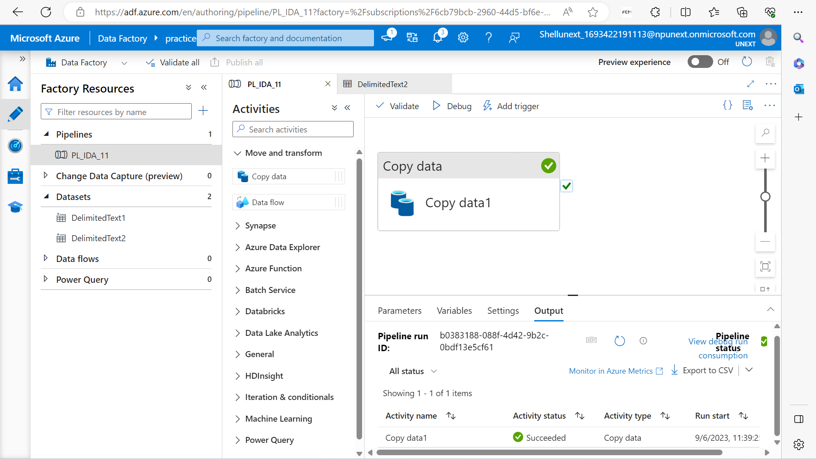
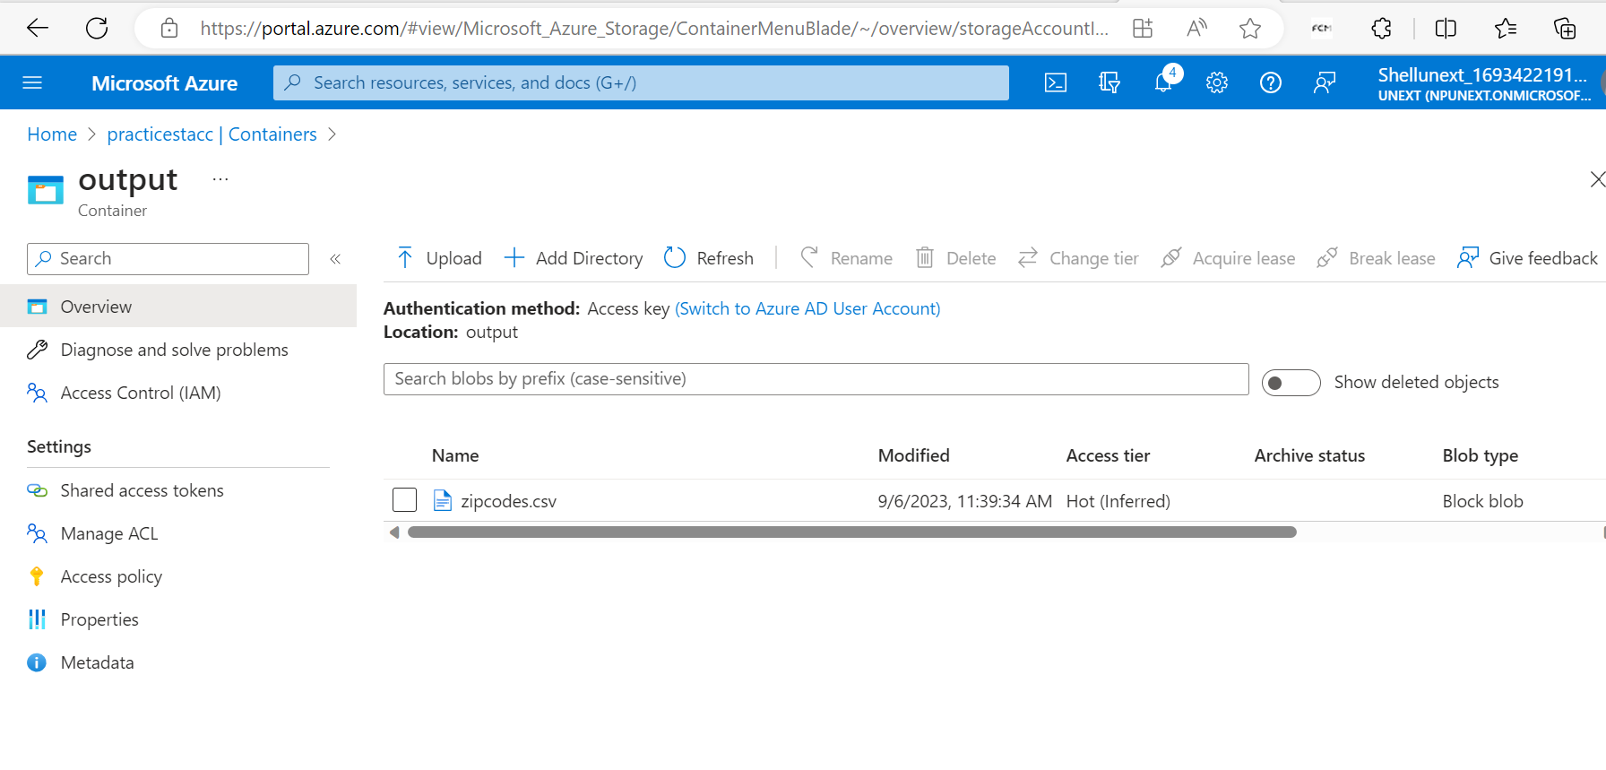
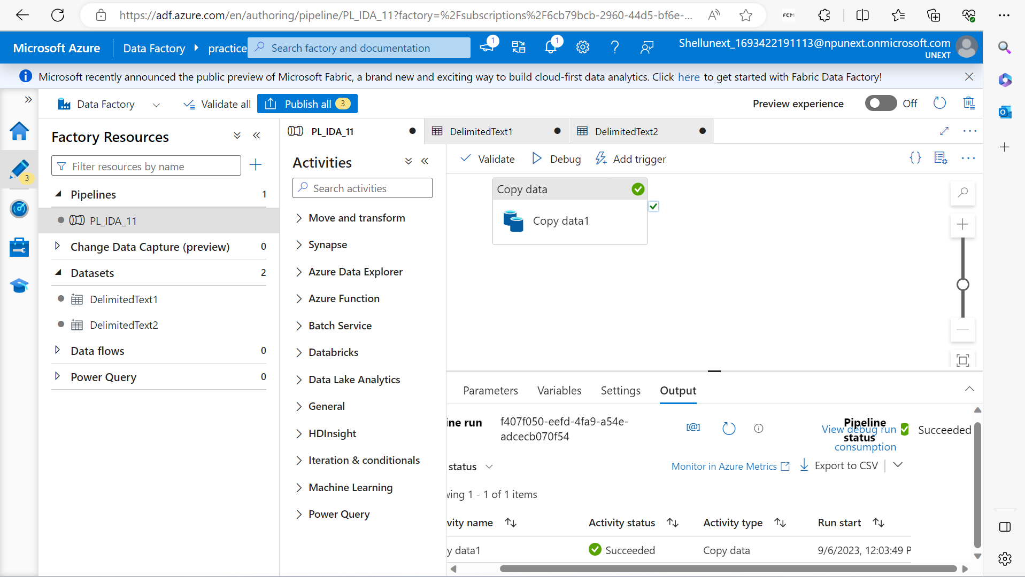
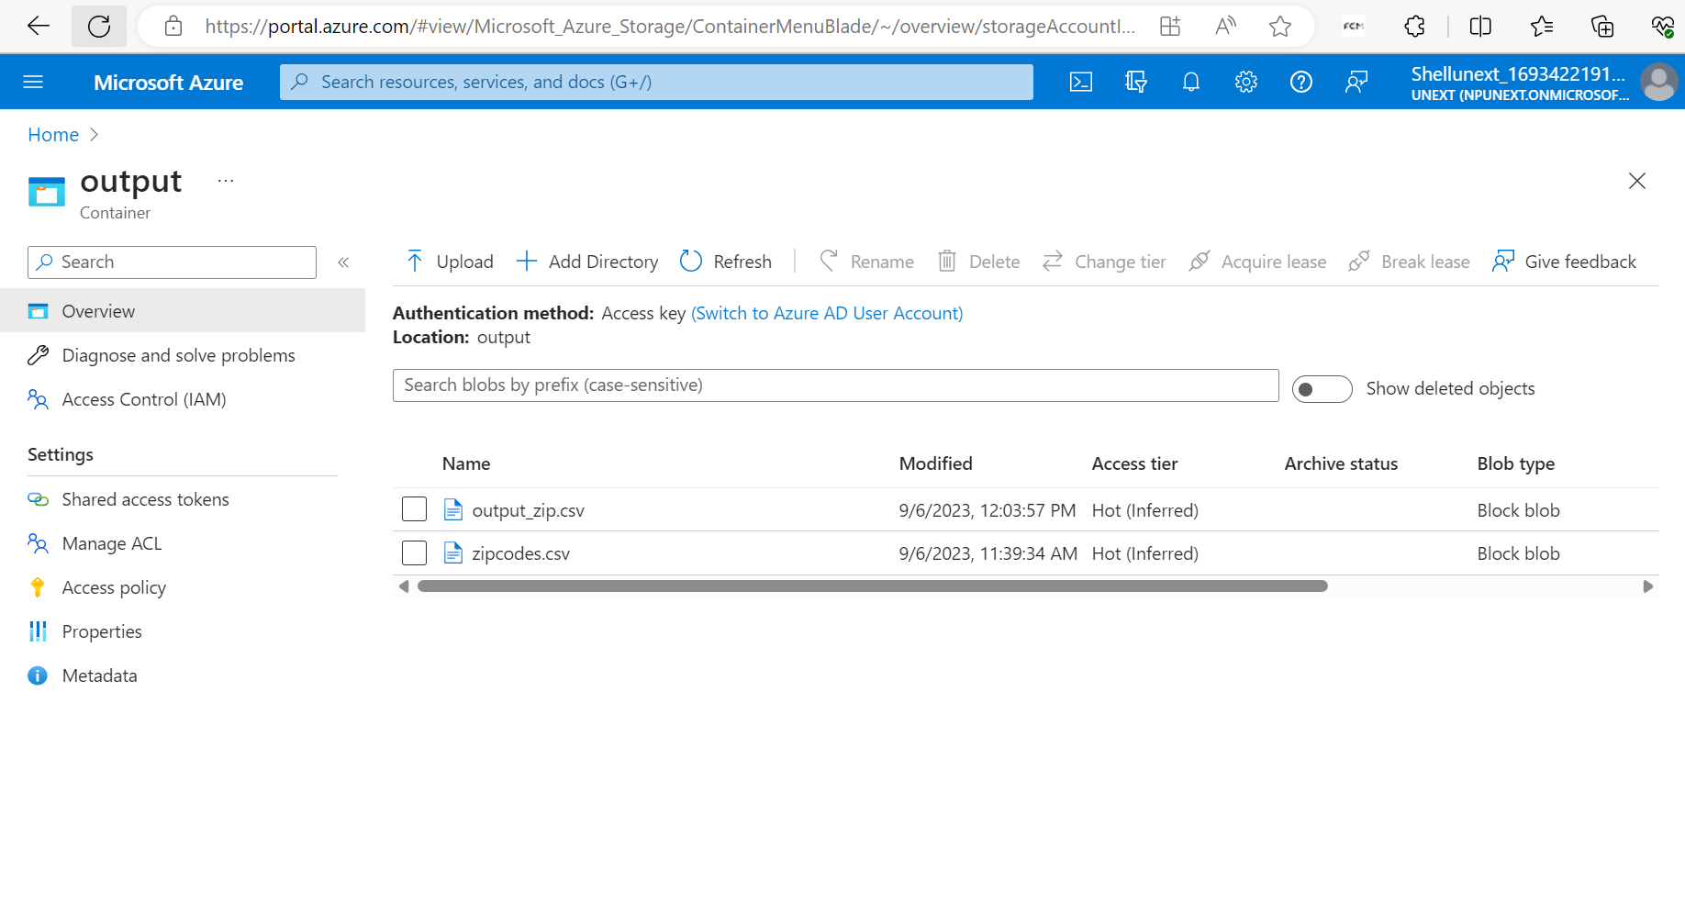

Slide 33
DAY-3
Create Data Factory
Activities In Pipeline :
String, Boolean, Array And Integer Activities In Pipelines
Execute Pipeline Activity
SSIS Package (Azure SSIS IR - Required For This Package)
Get Metadata Activity
Copy Data Activity Implementation
Parameter Concept Implementation
Triggers
Get Metadata Activity
If-else Condition For Get Metadata In Pipelines.
For Each Loop
Azure Data Factory - Day 1

Slide 34
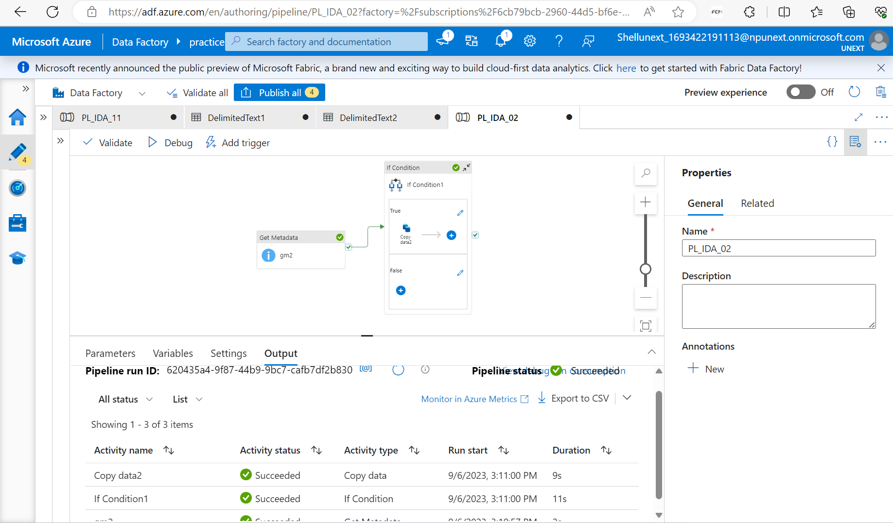
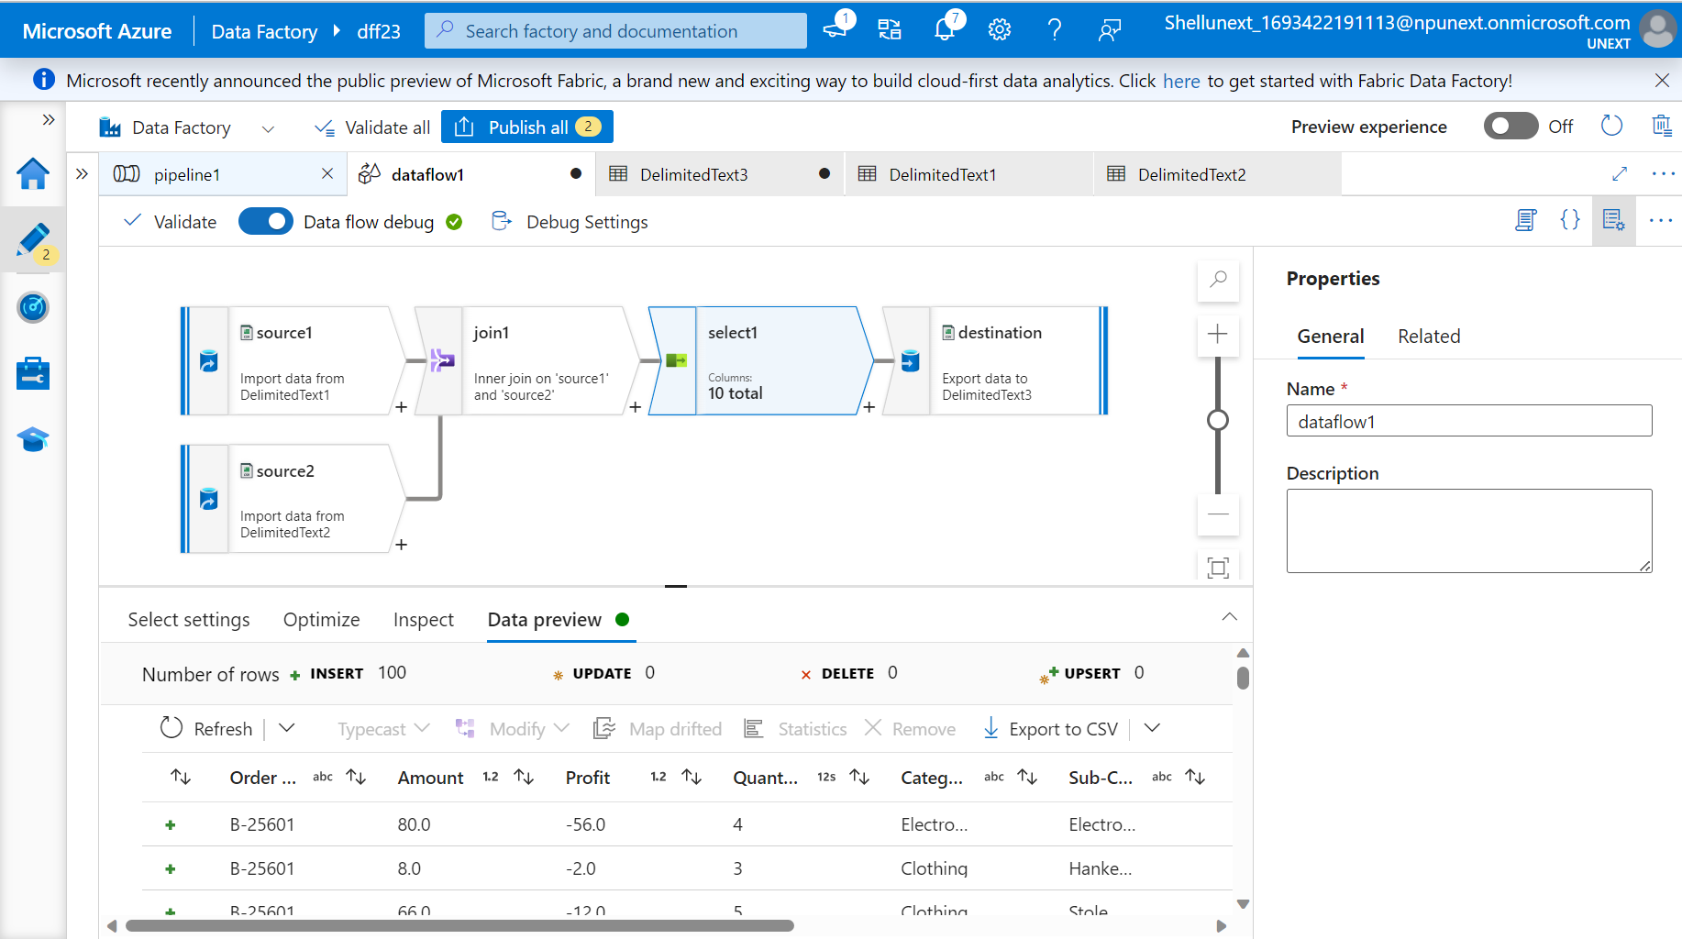

Slide 35
DAY-4
Data(resource)transformation Using Data Flow.
For Each Activity
Data Flows
Dataflow Expression Builder And Derived Columns
Surrogate Key
For Each Container And Get Metadata
API
Azure Data Factory - Day 2

Slide 36
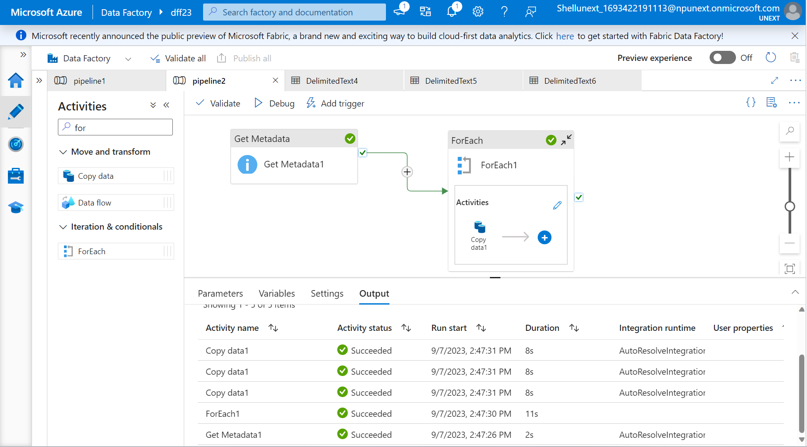
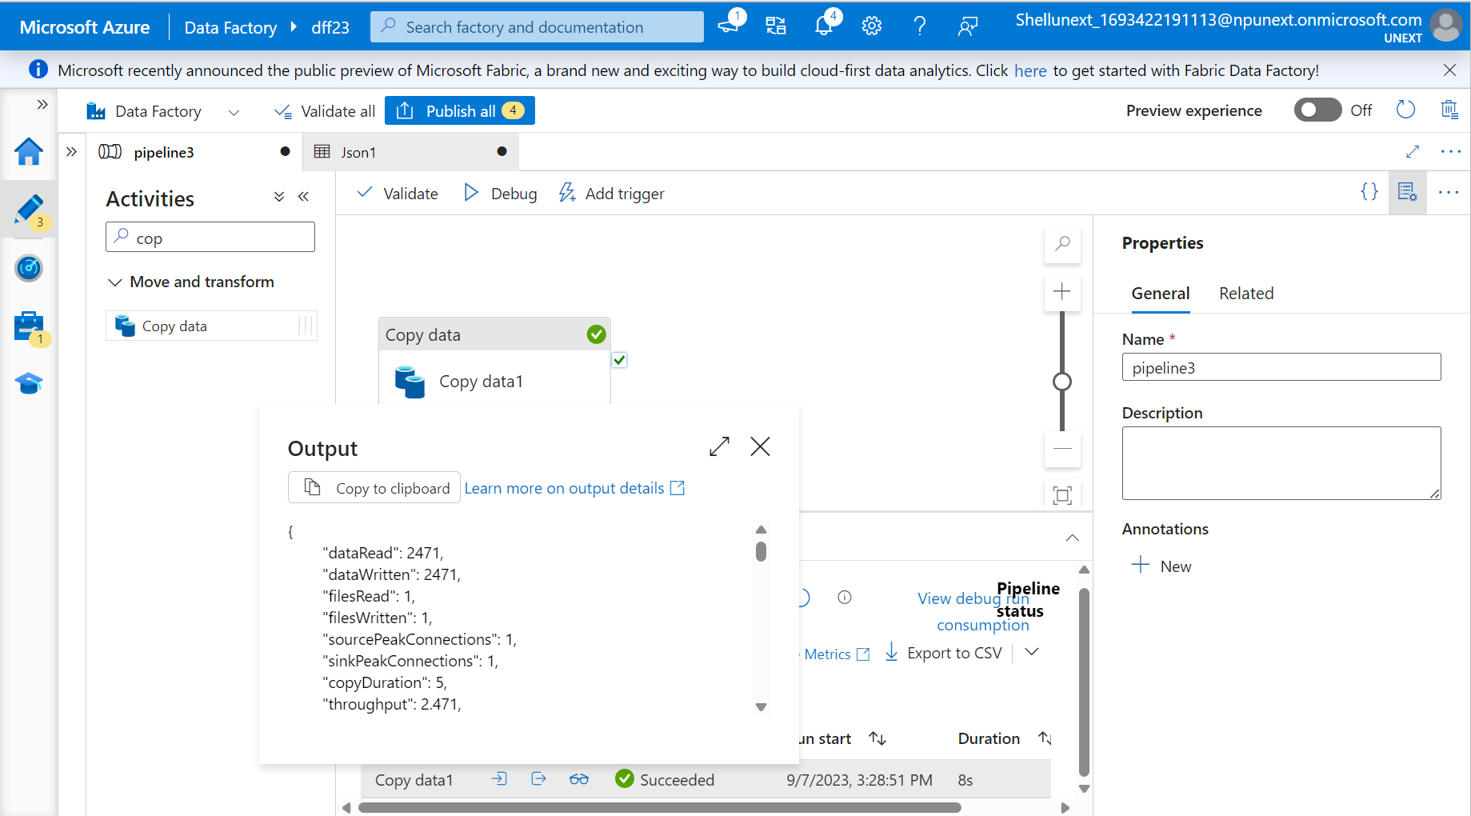

Slide 37
DAY-5
Create SQL Database On VM.
Lookup Table In Sql Database
Lookup Table With Foreach Pipeline
CDC (Change Data Capture)
Runbook Or Automation
Azure Data Factory - Day 3

Slide 38
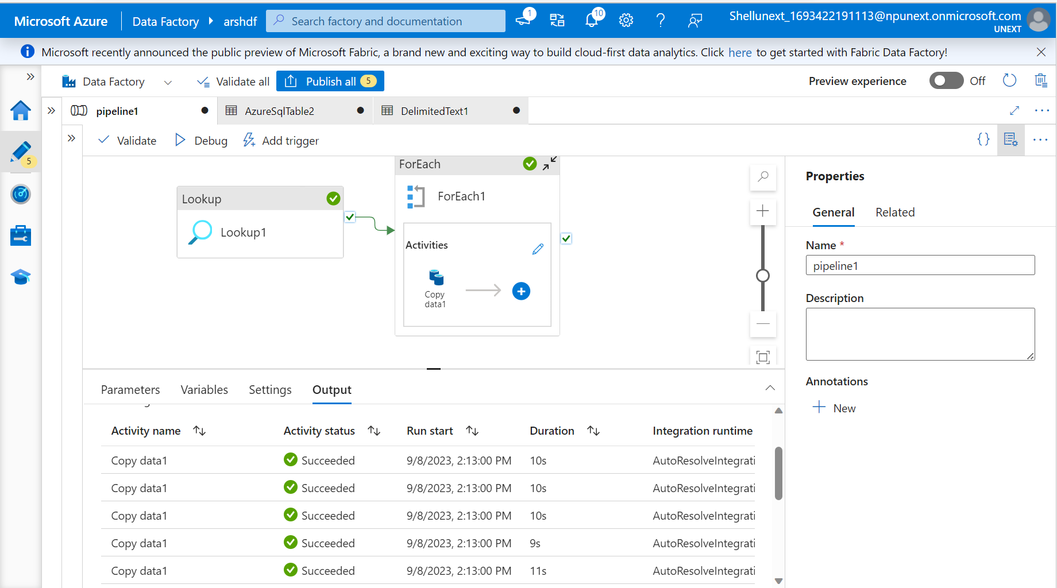

Slide 39
JOURNEY SCRAPBOOK
Custom Bootcamp (11th September – 15th September)
Week-5

Slide 40
DAY-1
Azure Synapse Analytics : Used To Create ADF Services, Spark Notebooks, SQL Data Warehouse
SQL Pools Offered
Serverless
Dedicated Pool
Spark Pool
Data Exploration
SQL Database
Collate
Common Table Expression (CTE)
View
DWU (Data Warehousing Unit)
Storage Node
Compute Node
Data Movement Service (DMS)
Massive Parallel Processing
Replicated Tables
Hash Distributed Table
Implementing Partitions For An SQL Data Warehouse
Azure Synapse Analytics

Slide 41
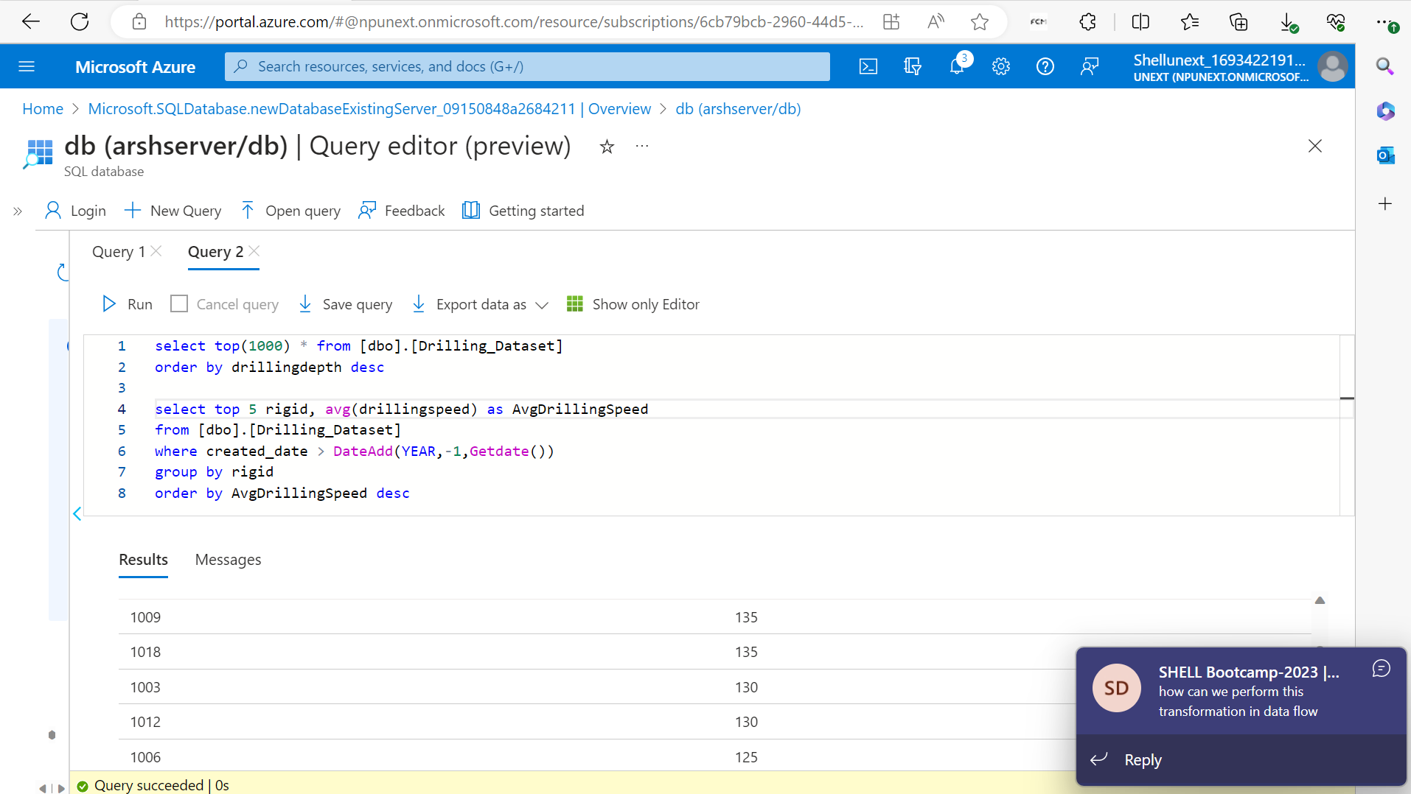
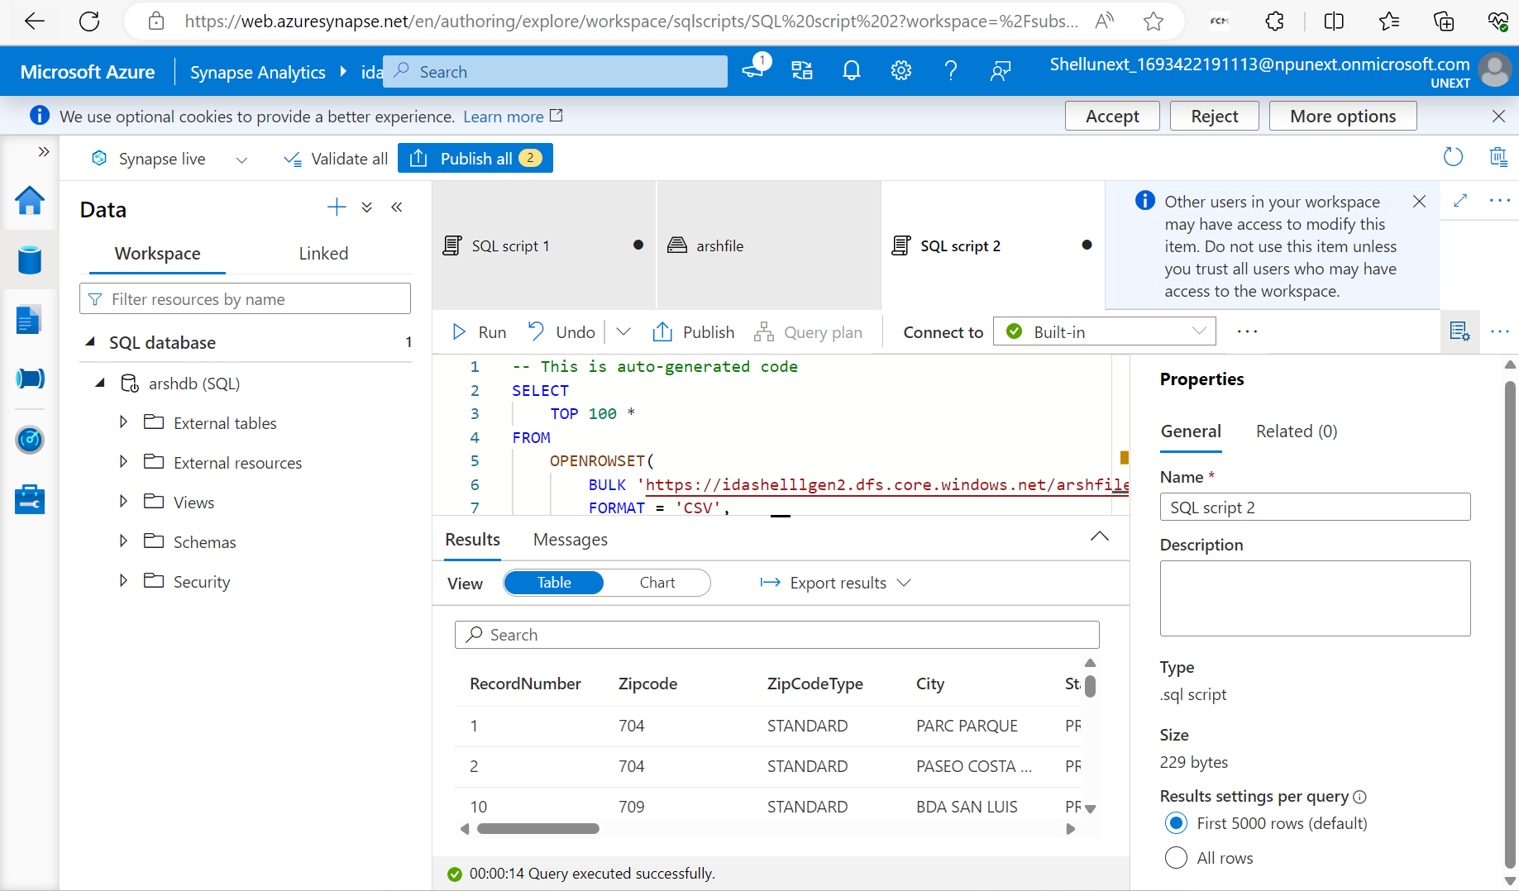
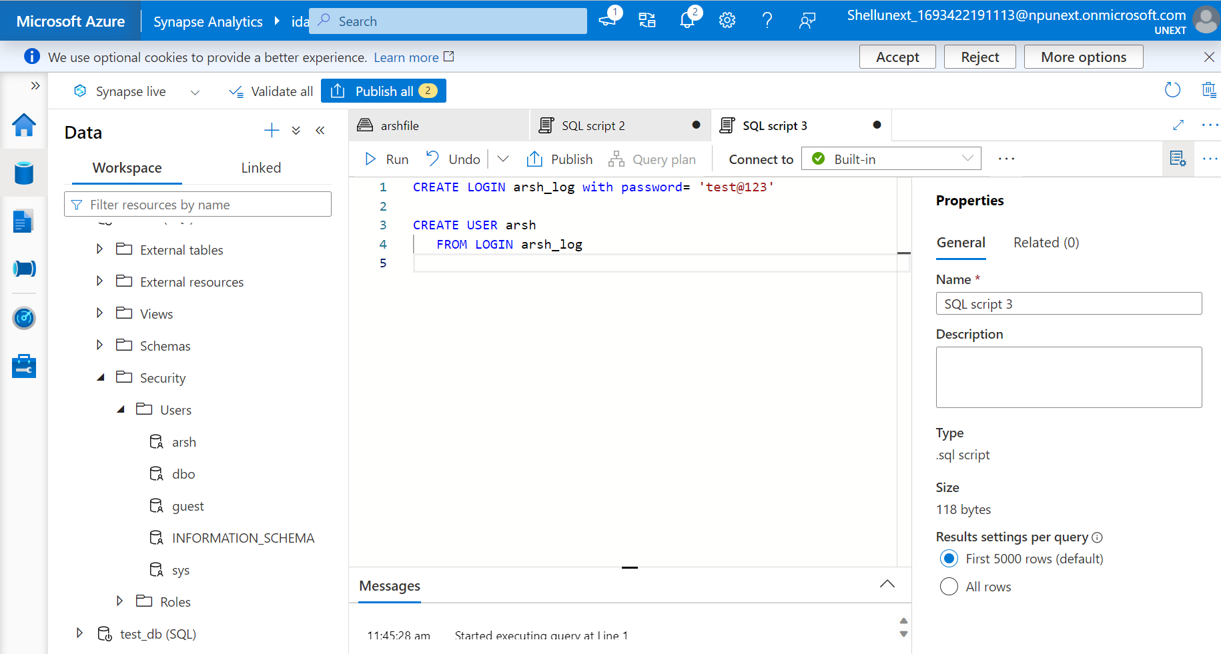
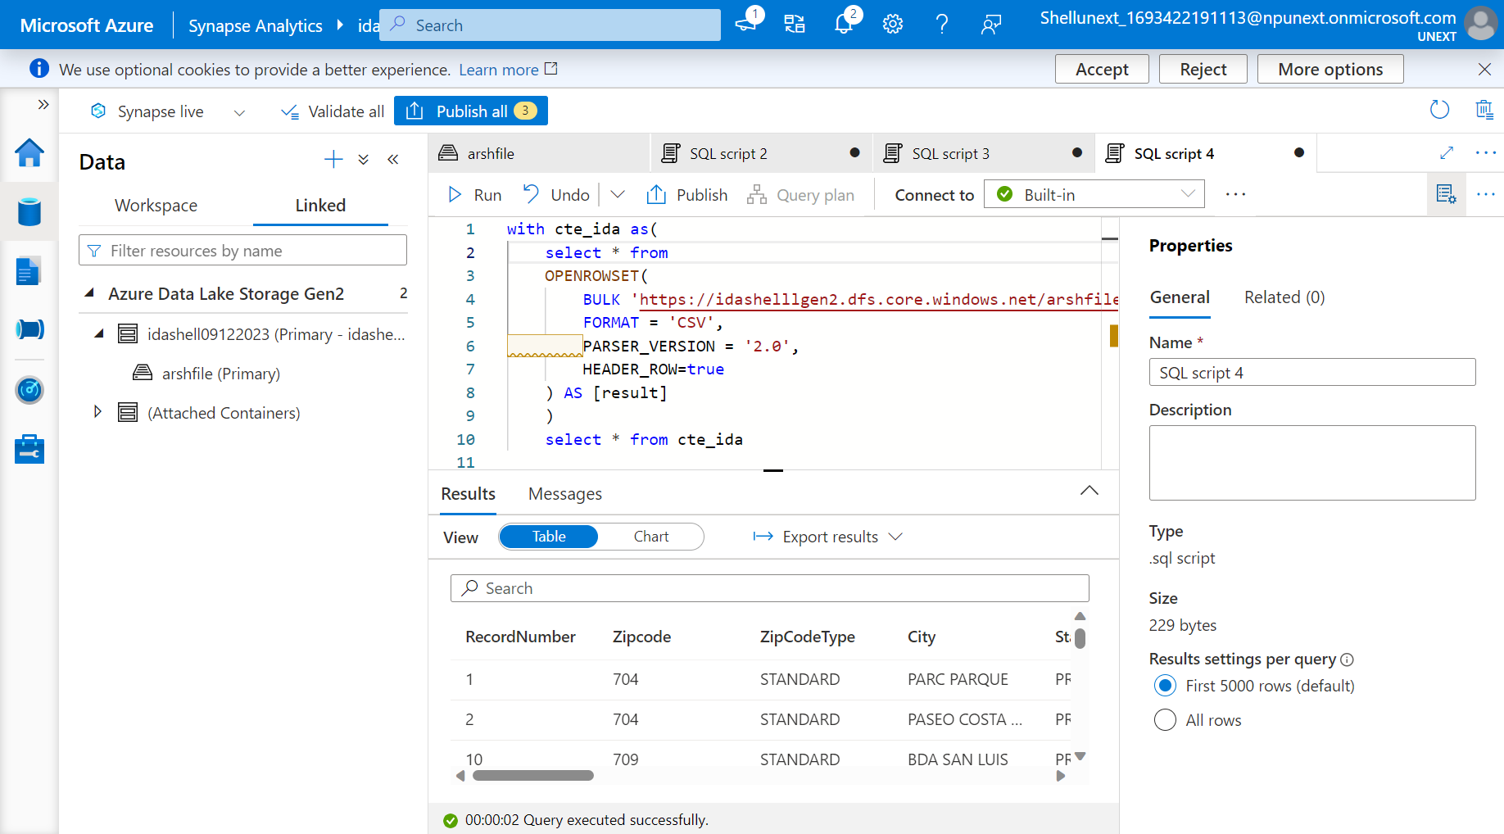

Slide 42
DAY-2
PBI Desktop
Power BI Supports Multiple Data Connectors.
Power Query Editor: Used To Transform Data
Language Used At Back-end - M Language
Different Fields Of This Editor
Get Data In PBI Report And Transform It In Power Query Editor
Getting Familiar With Different Visuals
Parameter
Filters :
Visual Level
Page Level
Report Level
Slicers
DAX Measures
DAX Calculated Columns
RLS (Manage Roles)
Data Visualization - Power BI

Slide 43
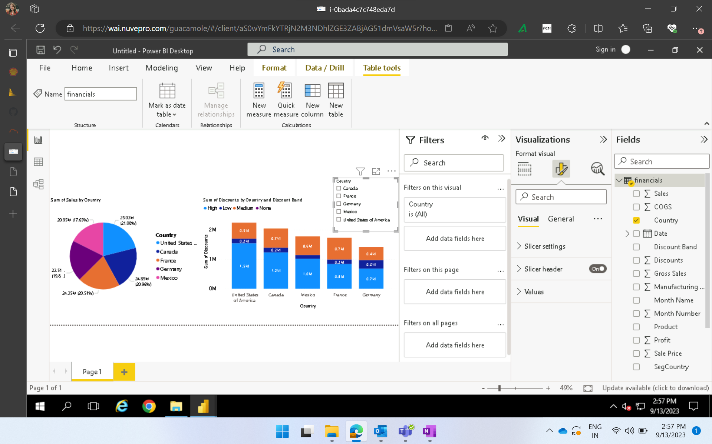

Slide 44
DAY-3
Data Modeling : Establishing Relationships Between Tables
Univariant
Bivariant
Multivariant
Drill Through
Date Table
Connection Of SQL Server And Power BI
Power BI - Day 2

Slide 45
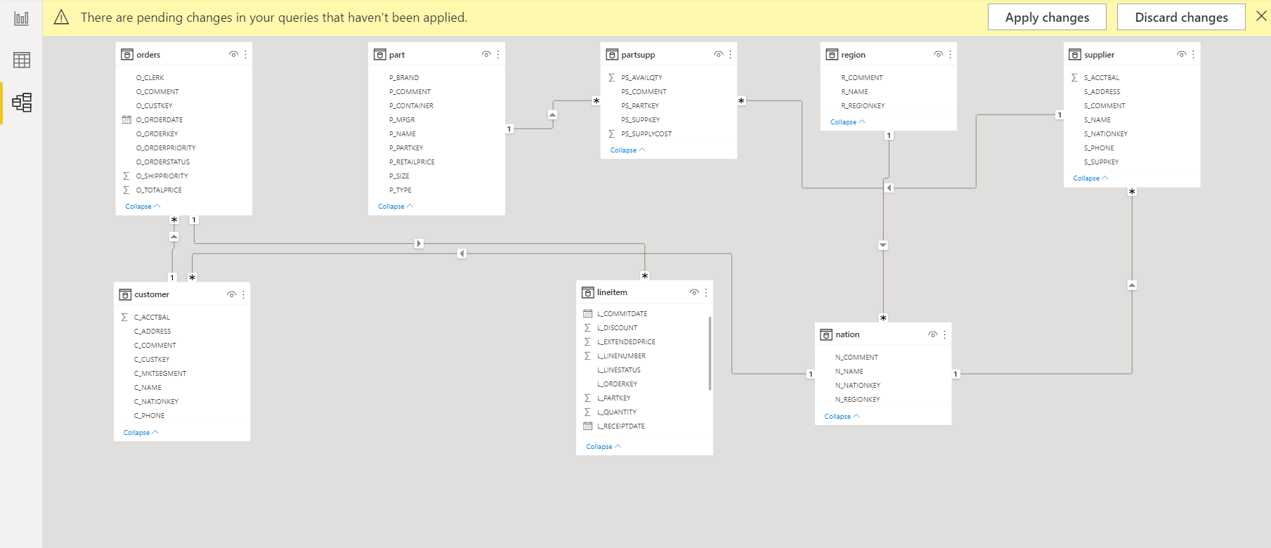
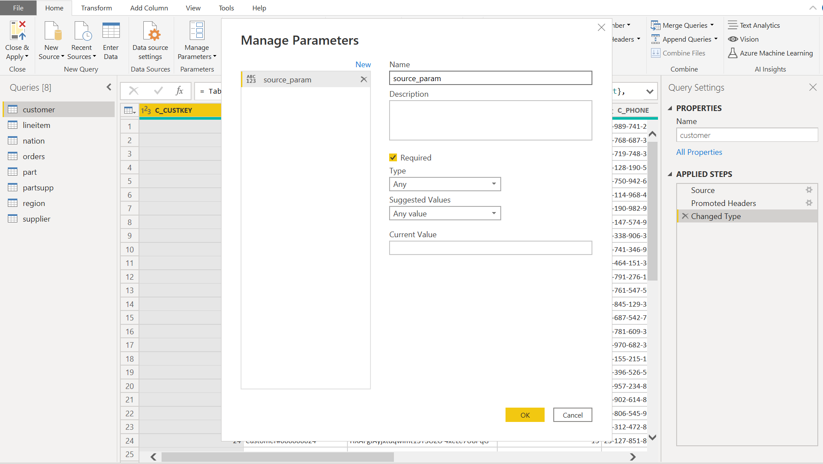
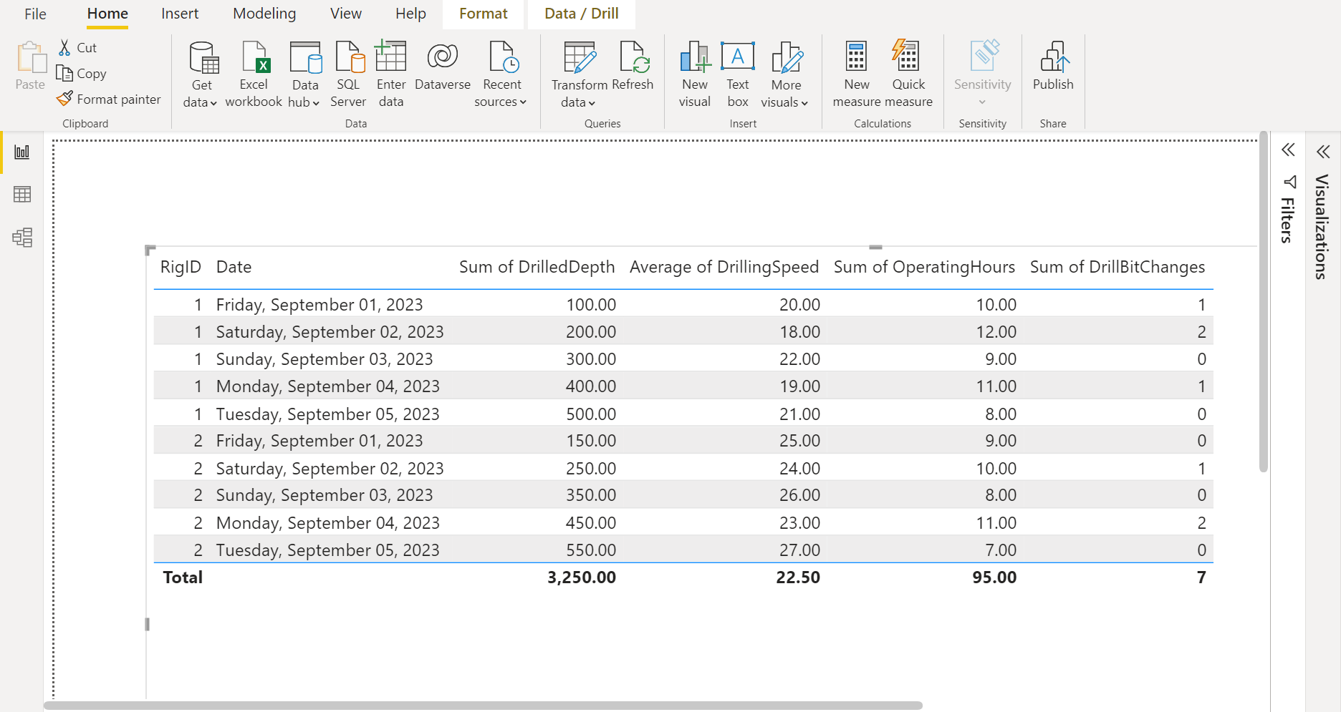
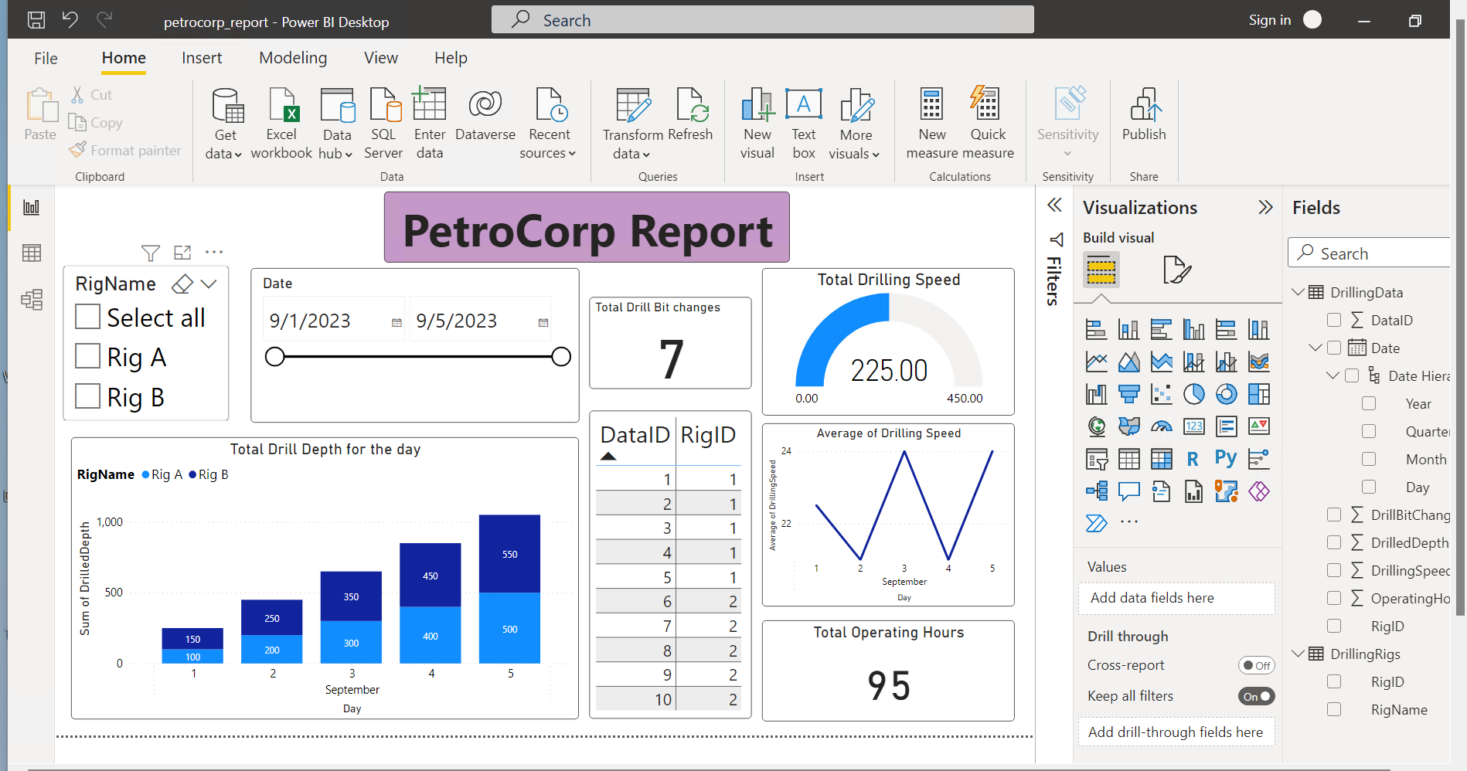

Slide 46
DAY-4
Hands-on Assessment - Power BI
Jupyter Notebook Launch
Datatypes In Python:
Integer
Float
String
List
Dictionary
Tuple
Boolean
Arithmetic
Logic
Python

Slide 47
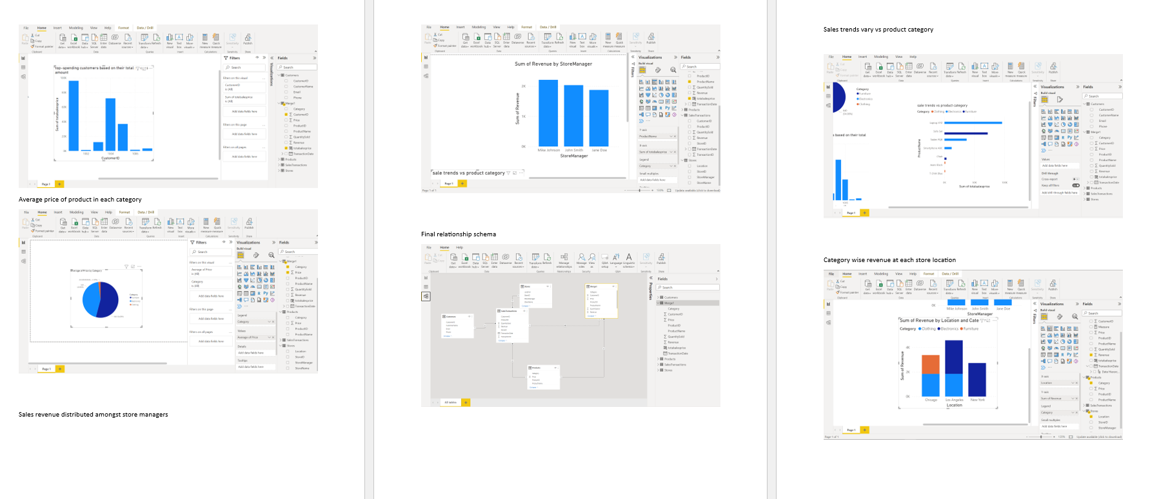
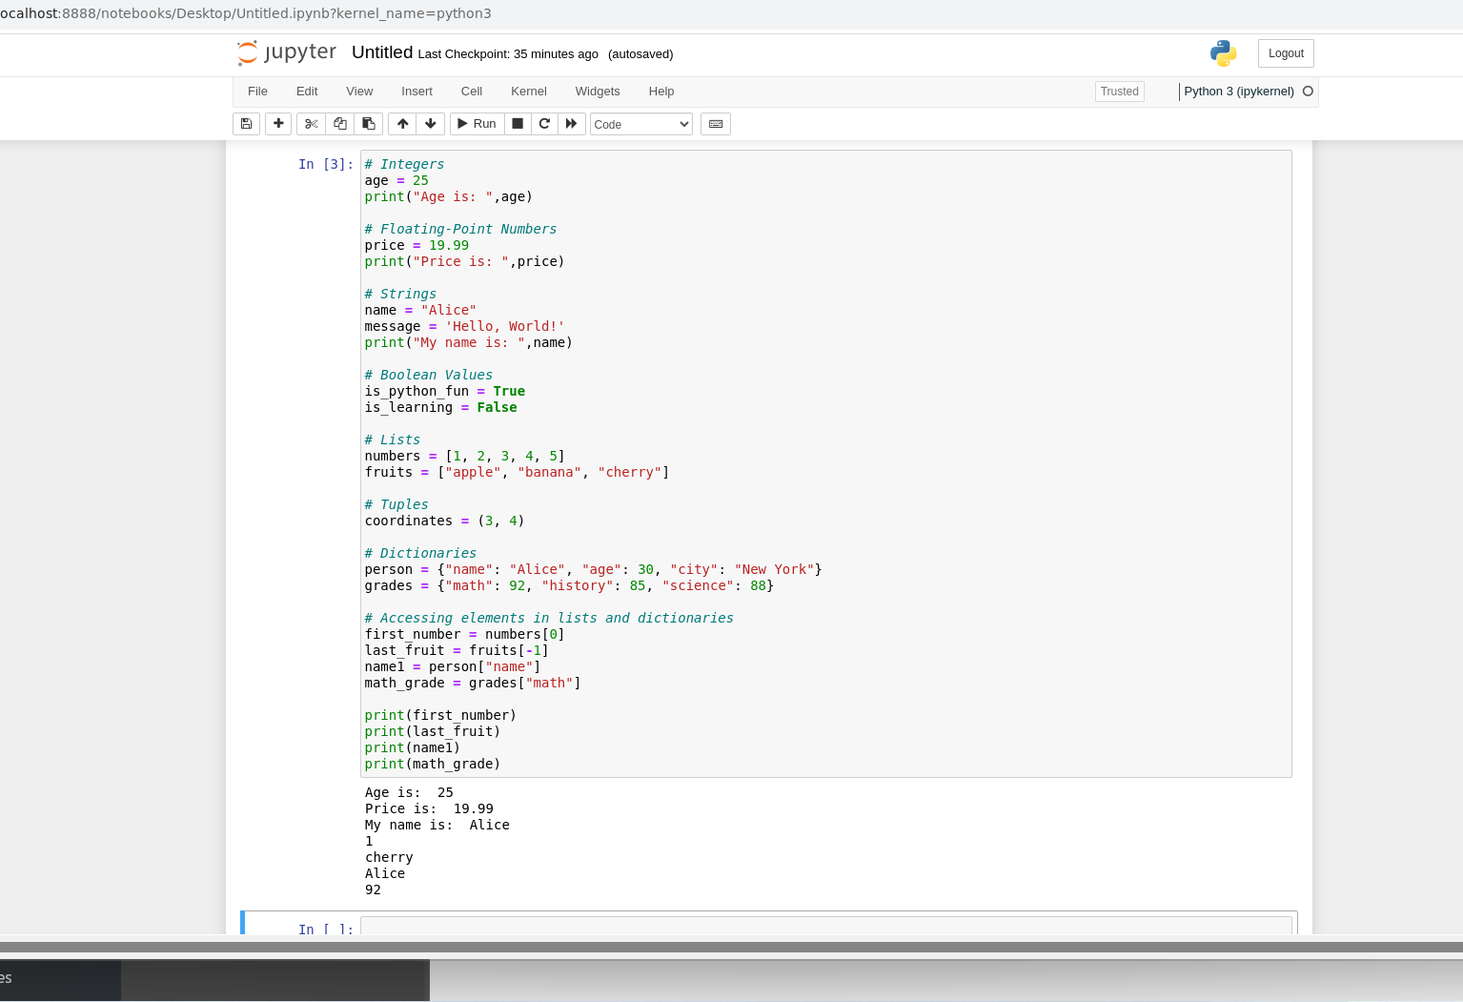
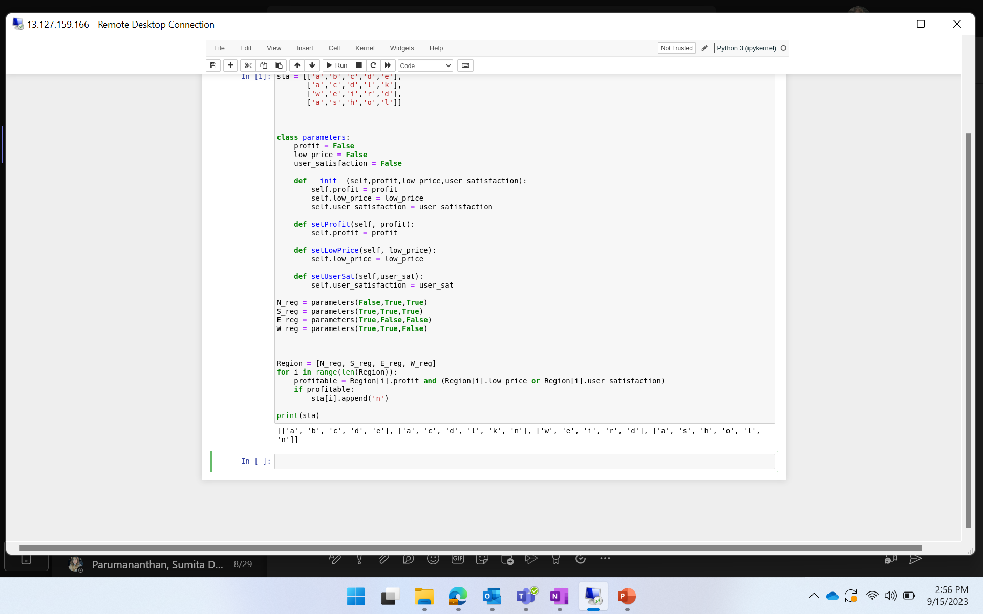

Slide 48
JOURNEY SCRAPBOOK
Custom Bootcamp
Week-6

Slide 49
DAY-1
Function
Function Composition
Recursive Function
Generator Function
Decorator (Wrap Function)
Types Of Argument
Class
Date Stripping
Date Conversion
Exception Handling
List Comprehension
Lambda Function
Python – Day 2

Slide 50
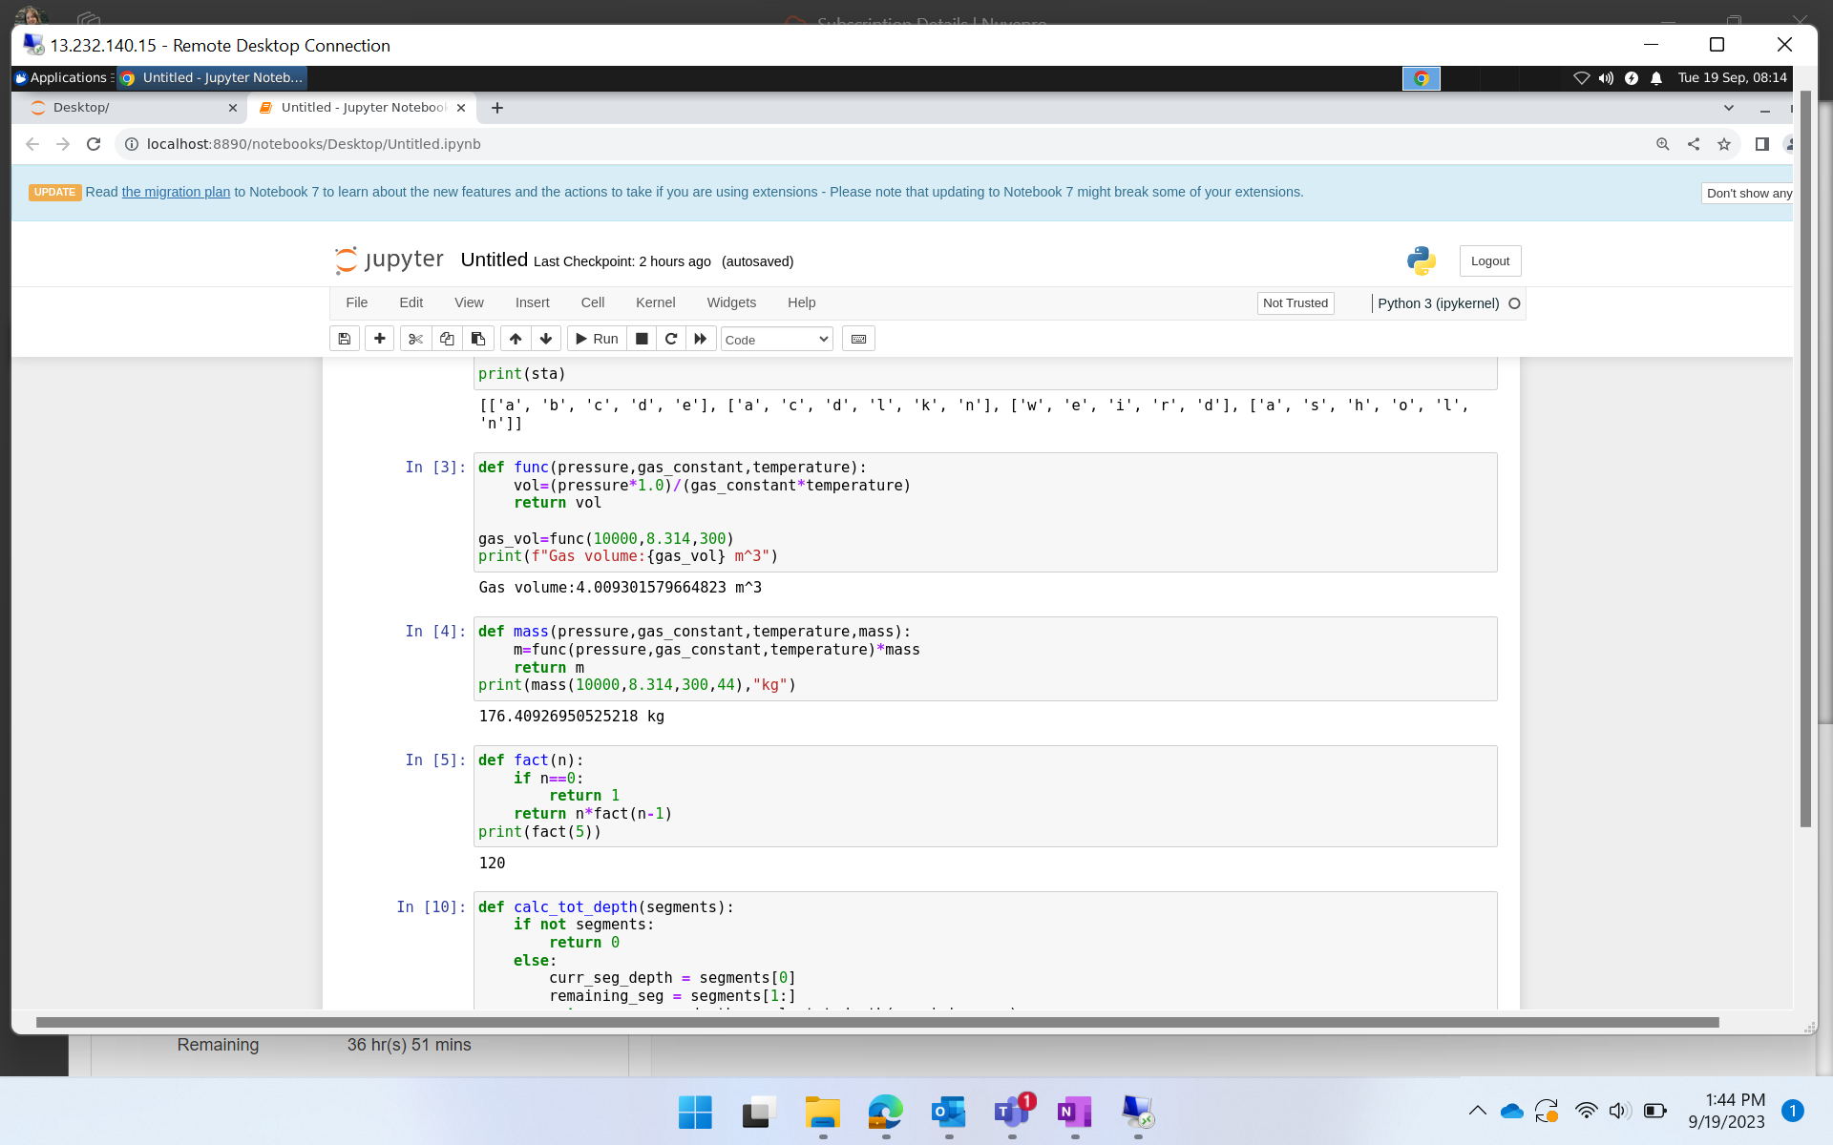
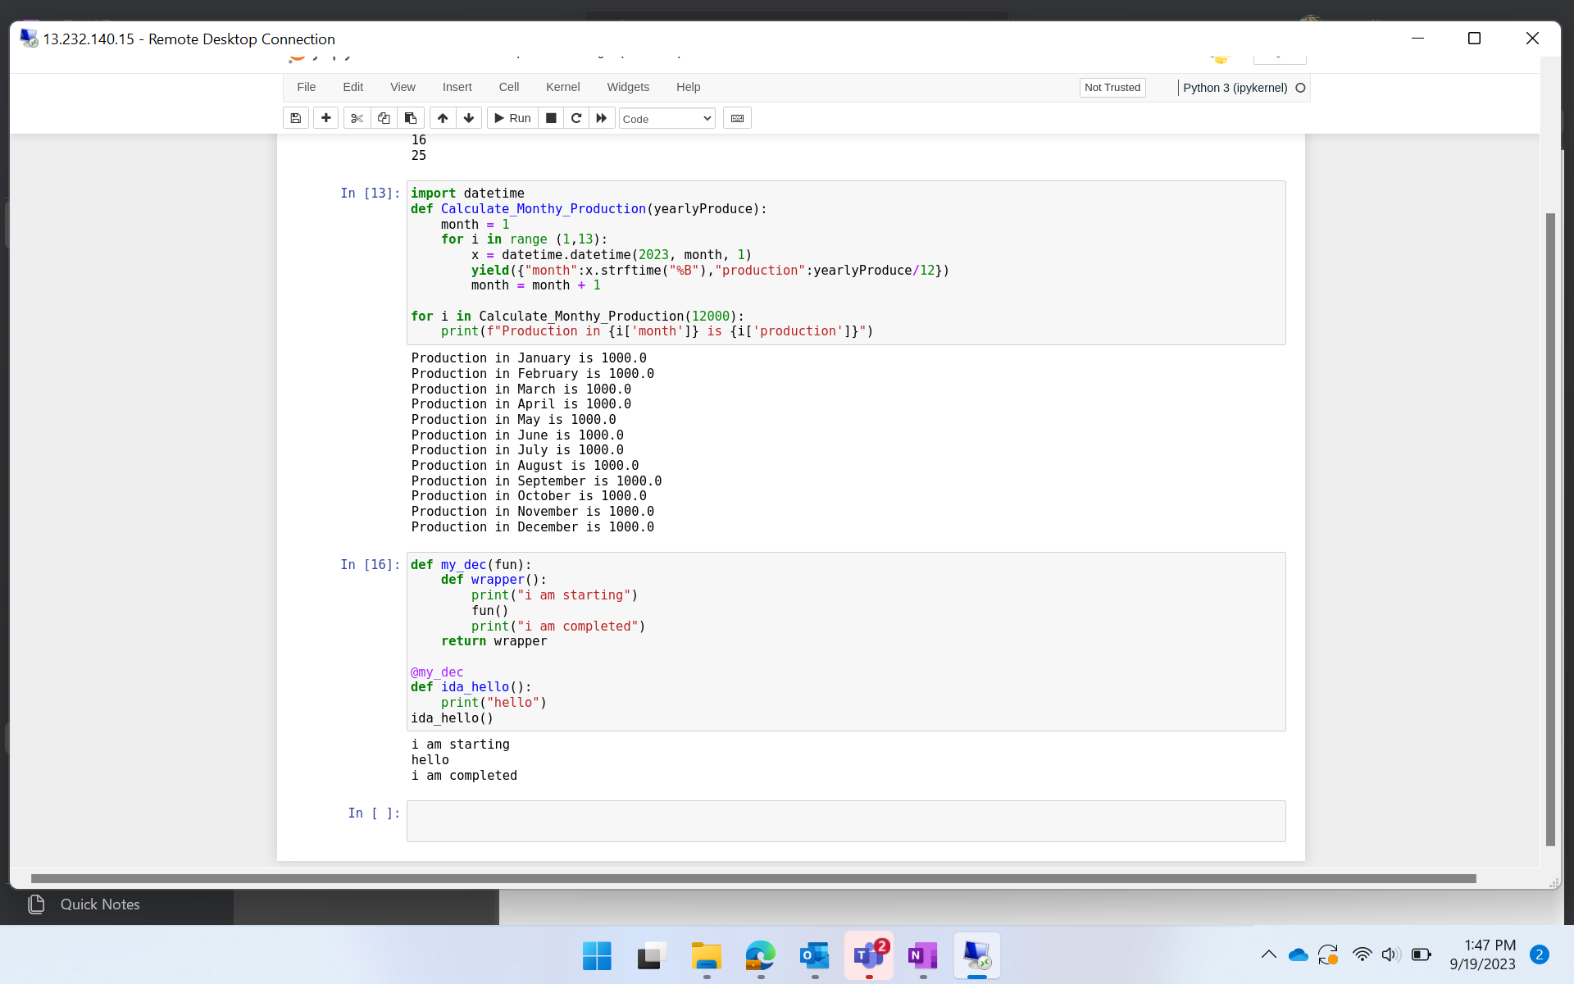
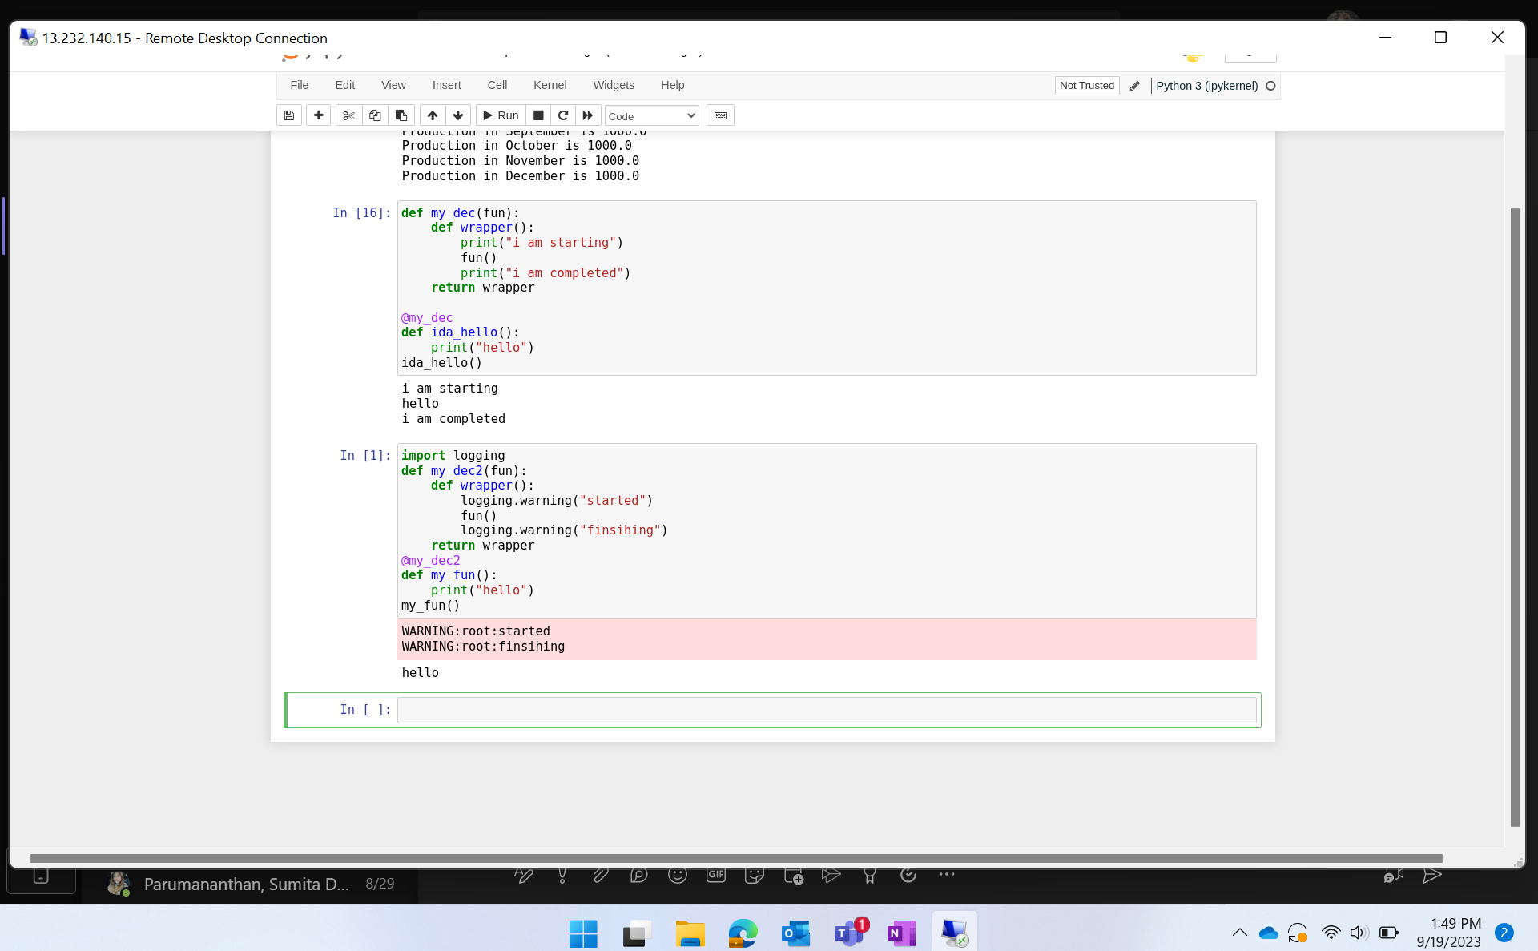
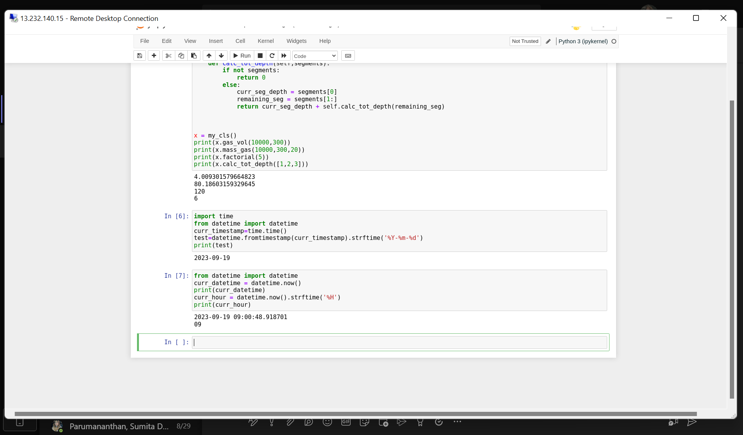
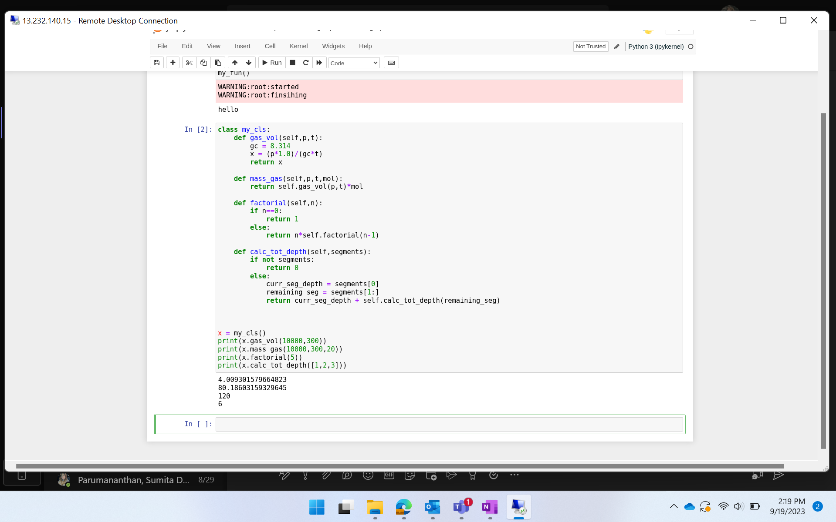
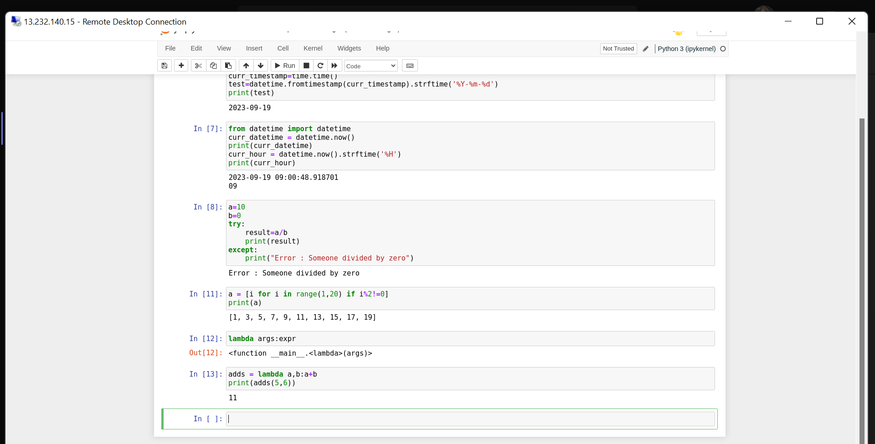

Slide 51
DAY-2
1. Pandas : Panel Datasets
a. Dataframe
b. Functions on dataframe
c. Changing column to lowercase
d. Dropping Null Values
e. Dropping columns with Null Values
f. Filling null values
g. Describe columns
h. Value counts()
i. Selected rows or columns of dataframe
j. Conditional selection
2. Matplotlib
3. Arrays In Python
Python – Day 3

Slide 52
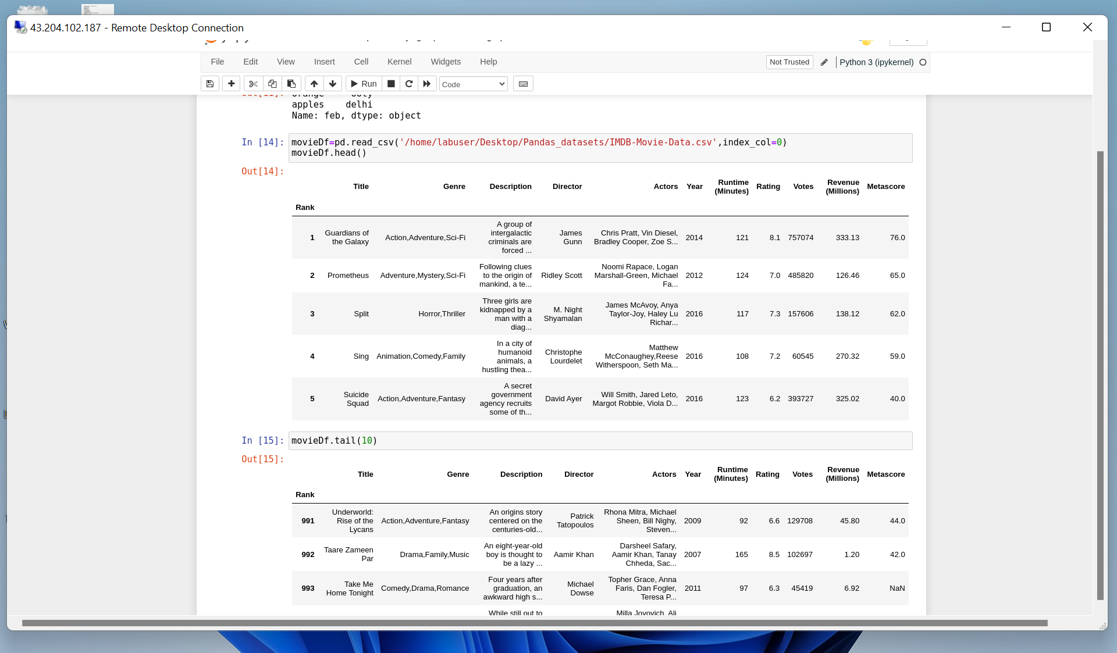
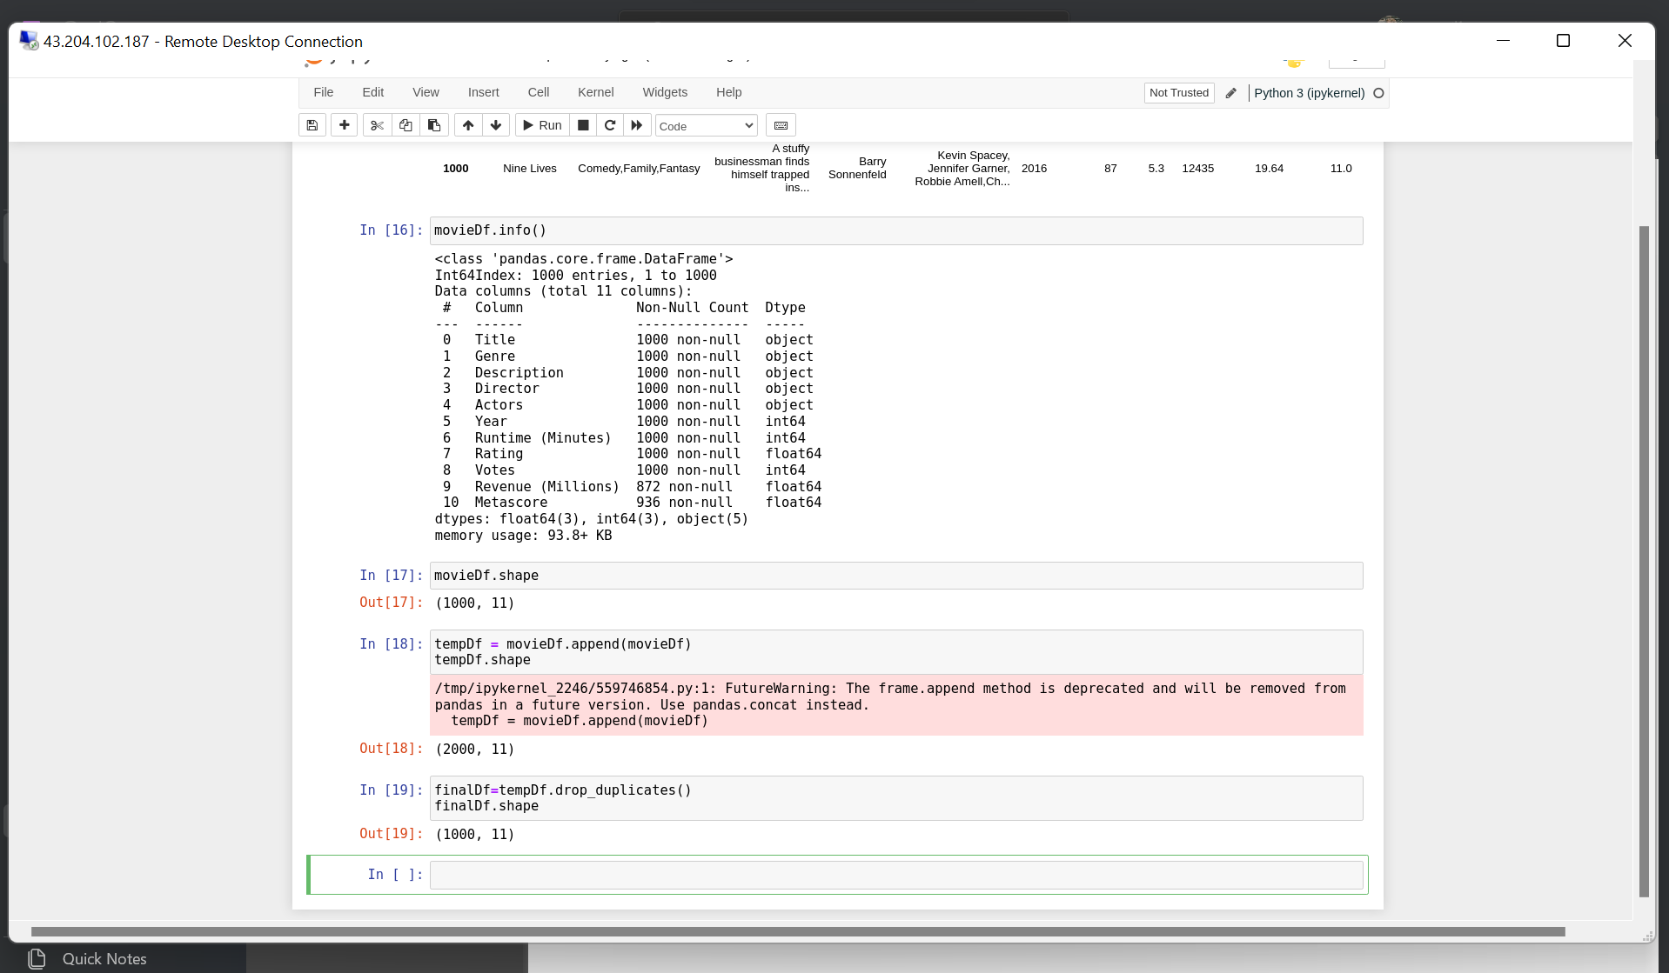





Slide 53
DAY-3
Driver process
Executors
Cluster Manager
Partition
Job, Stage and Task
Lazy Evaluation
RDD (Resilient Distributed Dataset)
Caching
Catalyst and Tungsten
RDD vs Dataframe
Deployment Types
Client Mode
Cluster Mode
Apache PySpark – Day 1

Slide 54





Slide 55
DAY-4
Partitioning
Spark UI URL
SQL in PySpark
Drop duplicates
When – Otherwise condition
Concat and Functions
Caching
Joins
GroupBy
Apache PySpark – Day 2

Slide 56






Slide 57
JOURNEY SCRAPBOOK
Custom Bootcamp
Week-7

Slide 58
DAY-1
Caching
Persist and different storage levels
Aggregation
Managed and External Tables
Partitioning
For-Each
Apache PySpark – Day 3
** Note : Only 4 hours training due to OneIDA event. **

Slide 59
DAY-2
What is databricks?
Setting Up azure databricks
Overview of Databricks Workspace
Cluster configuration
Mounting
Widgets
Parameters
Functions
%run, %md, %language
Structured streaming
Azure Databricks – Day 1

Slide 60


Slide 61
DAY-3
Structured streaming
DBFS from sample data
Delta table & Parquet table
Partition Tables
Medallion / Multi hop Architecture
Workflows → Jobs
Accessing data from Azure SQL database
Unity catalog in databricks
Metastore
Azure Databricks – Day 2

Slide 62





Slide 63
DAY-4
What is Docker ?
Docker initialization in VM
Build Docker image
Application
Requirement.txt
Dockerfile
Image created and Docker push
Azure container registry (ACR)
Kubernetes
AKS
Deploy a single-image application using code and UI
Docker Kubernetes

Slide 64



Slide 65
DAY-5
What is DevOps ?
Collaborative Branch (Main branch)
Feature branch
Azure DevOps
Boards
Repos
Pipelines
Test plans
Creating a project Board in Azure DevOps
Work items
Epic
Feature
User story
Tasks
Azure Repos
Azure Pipelines
Azure Deployment / DevOps

Slide 66
thank you

